Slide 1



Version Update Sheet – April 2020
Lesson I
Lesson II
Lesson III
Lesson IV
Lesson V
Lesson VI
Lesson VII
Updated to PowerPoint wide format slides.
Basics RSO Lesson Plan incorporated.
Updated Slide graphics.
Quick Lesson access menu added to slides.
Update: 04/2020
Notes:
Updated to PowerPoint wide format slides.
Basics RSO Lesson Plan incorporated.
Updated Slide graphics.
Quick Lesson access menu added to slides.

Slide 2

National Rifle Association
WELCOME TO THE NRA BASIC
RANGE SAFETY OFFICER COURSE
Robert D. Soule, Jr.
NRA Training Counselor
Chief Range Safety Officer
Update: 04/2020
Notes:
Min. Before class, prepare for your course with this slide up on the screen and:
• Have felt tip pens and name tags available for students to fill out.
• Set up any charts or visual aids.
• Have an extra light bulb if you are using an overhead projector.
• Have cups, stirrers, sugar, etc. available if coffee and/or refreshments are being offered.
• Have extra pens, pencils, and paper available for the students.
COURSE GOAL: To develop NRA Certified Range Safety Officers who possess the knowledge, skills, and attitude essential to organizing, conducting, and supervising safe shooting activities and range operations.
LENGTH OF COURSE: 9 hours. The course length may Vary depending on the instructor/student ratio and the participants' abilities.
STUDENT TEXT: NRA Basic Range Safety Officer Course Student Study Guide.
COURSE LESSONS:
Lesson I: Introduction to the NRA Basic Range Safety Officer Course
Lesson II: The Role of the Range Safety Officer and Range Standard Operating Procedures
Lesson ID: Range Inspection and Range Rules
Lesson IV: Range Safety Briefing
Lesson V: Emergency Procedures
Lesson VI: Firearm Stoppages and Malfunctions
Lesson VII: Test and Review
NRA RANGE SAFETY OFFICER STUDENT PACKET (EF 13520)
(Allow one per student)
Each packet contains the following items:
• NRA Basic Range Safety Officer Course Student Study Guide (EF 13524)
• NRA Gun Safety Rules Card (ES 39977)
OTHER MATERIALS & EQUIPMENT
• NRA Trainer's Guide (EF 13530) How to Introduce A Speaker (Appendix 0)
• NRA Home Firearm Safety or Rifle, Pistol, and Shotgun Instructional Wall Charts
• NRA Range Rules Poster (AR 14880)
• Range Perimeter Sign (AR 14836)
• Range Flag (AR 14835)
• NRA Range Source Book (AR 14840)
• Range first-aid kit
• Phone or radio (walkie-talkie)
• Long guns (six action types)
• Pistols (revolvers and semi-automatics)
• Muzzleloading firearms (flintlock or percussion)
• Air guns (rifle or pistol)
• BB guns (rifle or pistol)
• Dummy ammunition (to match the guns used in Lesson VI)

Slide 3

LESSON I: Introduction to the NRA
Basic Range Safety Officer Course
Slide I-1
Lesson I
Lesson II
Lesson III
Lesson IV
Lesson V
Lesson VI
Lesson VII
Learning Objectives:
Upon completion of this lesson, you should be able to:
      1. Understand the NRA’s Range Safety Officer Course.
      2. Explain the procedure for becoming an NRA Range Safety Officer.
      3. Explain the goal of the NRA Range Safety Officer Course
Notes:
LEARNING OBJECTIVES: Upon completion of this lesson, students should be able to:
1. Understand the NRA's Range Safety Officer Course.
2. Explain the purpose for becoming an NRA Range Safety Officer.
3. Explain the goal of the NRA Range Safety Officer Course.
Welcome Range Safety Officer (RSO) students. Identify yourself and members of your training team following the guidelines in your Trainer's Guide, "Introducing A Speaker."
• Give instructor's name. (Do not use nicknames.)
• Describe instructor's experience (shooting, training, range supervision).
• Describe instructor's NRA involvement (Life Member, NRA Certified Instructor, etc.).
• State the instructor's function in the course and why he or she was selected.
• Write key information on the chalkboard or easel pad. Include names of Chief Range Safety
Officer and Assistant Trainers.

Slide 4
Student Introductions
Slide I-2
Student Introductions to Include:
  Full Name
  Experience in Shooting, Training, and Range Supervision
  NRA Involvement
  Occupation
  How you intend to use this certification
PRACTICAL EXERCISE:
PREPARATION TIME: 5 MINUTES
PRESENTATION TIME: 1 MINUTE
Lesson I
Lesson II
Lesson III
Lesson IV
Lesson V
Lesson VI
Lesson VII
Notes:
Student Introductions
8Min. Cumulative Time: 13 Min.
Direct students to stand and give 30 second introduction of themselves using the outline on the slide.
Student Introductions to Include:
Full Name
Experience in Shooting, Training, and Range Supervision
NRA Involvement
Occupation
How you intend to use this certification
PRACTICAL EXERCISE:
PREPARATION TIME: 5 MINUTES
PRESENTATION TIME: 1 MINUTE

Slide 5
Course Introduction
Slide I-3
No Live Ammunition, Percussion Caps, Propellants, or Projectiles in the Classroom and Practical Exercise area
Schedule of Events – Refer to course itinerary
Facilities
Security
Student Study Guide matches the slide presentation
RSO test is open book
  You may work on the test during the breaks
Lesson I
Lesson II
Lesson III
Lesson IV
Lesson V
Lesson VI
Lesson VII
Notes:
Course Introduction
3 Min. Cumulative Time: 16 Min.
No Live Ammunition, Percussion Caps, Propellants, or Projectiles in the Classroom
Schedule of Events – Refer to the course itinerary which is with your student package
Schedule will be adapted to course progress, experiences of students and additional information which is reviewed.
Facilities
Bathroom
Coffee
First Aid Kit
CPR certified?
Security
You are responsible for your personal items and equipment.
Student Study Guide matches the slide presentation
This study guide is your resource for the test.
RSO test is open book
Maybe worked on during the breaks.
Fifty multiple choice questions.
Ninety per cent to pass the test.
You may work on the test during the breaks

Slide 6
Course Goal
Slide I-4
To develop NRA Certified Range Safety Officers who possess the knowledge, skills, and attitude essential to organizing, conducting, and supervising safe shooting activities and range operations.
Lesson I
Lesson II
Lesson III
Lesson IV
Lesson V
Lesson VI
Lesson VII
Notes:
Course Goal
3Min Cumulative Time: 19 Min.
What do each of you hope to learn during this course?
To develop NRA Certified Range Safety Officers who possess the knowledge, skills, and attitude essential to organizing, conducting, and supervising safe shooting activities and range operations.
RSOs will refine their knowledge and skills with experience.
Of the three attributes (knowledge, skills, attitude), attitude is the most important when it comes to safety.
RSO must be alert and ready to perform duties and responsibilities as appropriate.
This course will not be able to prepare students for every possible situation.
Standard Operating Procedures serve as the RSO’s guidebook on how to perform duties and responsibilities. The Range SOP also outlines the steps necessary to organize, conduct and supervise safe shooting activities and range operations at a specific range.

Slide 7
Course Lessons
Slide I-5
Topics Include:
  Defining the role of the Range Safety Officer (RSO).
  The purpose of range Standard Operating Procedures (SOP).
  Procedures for inspecting a range prior to live fire.
  Conducting a range safety briefing.
  Emergency procedures.
  How to safely unload guns and correct stoppages and malfunctions.
Lesson I
Lesson II
Lesson III
Lesson IV
Lesson V
Lesson VI
Lesson VII
Notes:
Course Lessons
2 Min. Cumulative Time: 21 Min.
Topics Include:
Defining the role of the Range Safety Officer (RSO).
RSOs must know and understand their duties and responsibilities in order to function effectively.
The purpose of range Standard Operating Procedures (SOP).
The range SOPs serve as the RSO’s guidebook. They specify how all activities are conducted on the range and how the range is to be used for the purposes for which it was designed.
Procedures for inspecting a range prior to live fire.
Prior to conducting live fire, the RSO must take certain steps to ensure that the range, range equipment, and range conditions are safe and functional. Checklists, which should be part of range Standard Operating Procedures (S.O.P.s), are often used to guide the RSO with each item specified for that range.
Conducting a range safety briefing.
RSOs learn a simple method of informing range users about what takes place on the range.
Emergency procedures.
Will learn a methodical approach to handle emergencies by following an emergency response plan.
How to safely unload guns and correct stoppages and malfunctions.
The RSO should follow standardized methods to ensure that the range, range equipment, and range conditions are safe and functional.
2Min. Cumulative Time: 23 Min.
• Explain how to conduct a range safety briefing.
• RSOs learn a simple method of informing range users about what takes place on the range.
• Explain procedures that should be implemented during an emergency.
• RSOs use a step-by-step approach to handle emergencies by following an emergency response plan.
♦ Demonstrate how to safely unload and correct firearm and air gun stoppages and malfunctions.
• The RSO should follow standardized methods to ensure that the range, range equipment, and range conditions are safe and functional.

Slide 8
Certification Requirements
Slide I-6
Lesson I
Lesson II
Lesson III
Lesson IV
Lesson V
Lesson VI
Lesson VII
21 years old or older
Attend the entire course.
Participate in discussions and practical exercises.
Demonstrate knowledge, skills, and attitudes necessary to organize, conduct, and supervise safe shooting activities and range operations.
Achieve an examination score of 90% or higher.
Finalize credentialing at nrainstructors.org
Notes:
Certification Requirements
1.5Min. Cumulative Time: 24.5 Min.
State certification requirements.
Explain that students need to:
• Participate in discussions.
• Participate in role play and practical exercises.
Emphasize that students must meet all requirements to be eligible to receive certification
21 years old or older
Attend the entire course.
Participate in discussions and practical exercises.
Demonstrate knowledge, skills, and attitudes necessary to organize, conduct, and supervise safe shooting activities and range operations.
Achieve an examination score of 90% or higher.
Finalize credentialing at nrainstructors.org

Slide 9
Lesson II Preview
Slide I-7
Lesson I
Lesson II
Lesson III
Lesson IV
Lesson V
Lesson VI
Lesson VII
      In Lesson II we will learn about:
The role of the Range Safety Officer.
The purpose of having range Standard Operating Procedures.
What are your questions?
Notes:
Lesson I Conclusion
Learning Objectives:
During this lesson, you learned and should be able to:
1. Understand the NRA’s Range Safety Officer Course.
2. Explain the procedure for becoming a NRA Range Safety Officer.
3. Explain the goal of the NRA Range Safety Officer Course
In Lesson II we will learn about:
The role of the Range Safety Officer.
The purpose of having range Standard Operating Procedures.
What are your questions?
.5 Min. Cumulative Time: 25 Min.
Preview the next lesson by stating what the students will learn.
Instructor's Option:
Lesson II is only a 20-minute class. To stay on time, you need to start immediately. A break may be needed here, however, so observe the class and decide what is best for you.

Slide 10
LESSON II: Role of the Range Safety Officer and Range Standard Operating Procedures
Slide II-1
Lesson I
Lesson II
Lesson III
Lesson IV
Lesson V
Lesson VI
Lesson VII
Learning Objectives:
  Upon completion of this lesson, you should be able to:
      Explain the role of the Range Safety Officer (RSO).
      Explain the purpose of having range Standard Operating Procedures (SOP).
Notes:
LESSON II: Role of the Range Safety Officer and Range Standard Operating Procedures
Learning Objectives:
Upon completion of this lesson, you should be able to:
Explain the difference between a Range Safety Officer (RSO) and a Chief Range Safety Officer (CRSO).
RSOs need to have a basic understanding of the Chief Range Safety Officer’s role to enable them to work together as a team.
Explain the duties of a Range Safety Officer (RSO).
To effectively serve as a RSO, you must make sure all persons on the facility follow range regulations, which will reduce property damage and preclude personal injury.
Explain the responsibilities of a Range Safety Officer.
RSOs must understand their responsibilities which often include taking action during circumstances where duties were not assigned.
Explain the purpose of having range Standard Operating Procedures (SOP).
Range SOPs provide guidelines for all activities that occur on a range. SOPs include shooting range rules, emergency response plans, and other information needed to conduct safe shooting activities and range operations consistent with the purposes for which the range was designed.
LEARNING OBJECTIVES: Upon completion of this lesson, students should be able to:
1. Explain the role of the Range Safety Officer (RSO).
2. Explain the purpose of having range Standard Operating Procedures (SOPs).
===================
Length: 20 Minutes
Facility: Classroom
Training Materials:
• NRA Basic Range Safety Officer Course Student Study Guide (one per student)
· Notepads and pencils (one per student)
· Viewgraphs
· Training aids as appropriate: chalk, eraser, blackboard, flipchart, easel, markers, overhead projector, bulbs, screen, etc.
Reference:
NRA Range Source Book

Slide 11
The Role of the Range Safety Officer
Slide II-2
Lesson I
Lesson II
Lesson III
Lesson IV
Lesson V
Lesson VI
Lesson VII
The Range Safety Officer (RSO) supervises shooting activities as prescribed by the range Standard Operating Procedures (SOP).
Notes:
The Role of the Range Safety Officer
The Range Safety Officer (RSO) supervises shooting activities as prescribed by the range Standard Operating Procedures (SOP).

Slide 12
The Role of the Chief Range
Safety Officer
Slide II-3
Lesson I
Lesson II
Lesson III
Lesson IV
Lesson V
Lesson VI
Lesson VII
The Chief Range Safety Officer (CRSO) trains RSOs and has overall responsibility for safe gun handling and shooting everywhere on the range premises.
The CRSO develops a range’s SOP as directed by the range owners.
Conducts Range Safety Officer training.
Notes:
The Role of the Chief Range Safety Officer
2Min. Cumulative Time: 8 Min.
The Chief Range Safety Officer (CRSO) trains RSOs and has overall responsibility for safe gun handling and shooting everywhere on the range premises.
May be the range owner, operator, manager or someone who reports directly to any or all of them.
Responsible for the date handling and shooting of firearms and air guns anywhere on the range property.
Trains, coordinates, and supervises RSOs.
Develops range Standard Operating Procedures which are directed and approved by the range organizations.
The CRSO develops a range’s SOP as directed by the range owners.
The CRSO receives additional training on how to develop the range SOPS and how to conduct the RSO course.
Conducts Range Safety Officer training.
To become a Chief Range Safety Officer:
Must be a NRA Range Safety Officer.
Complete the NRA Basic Instructor Training (BIT) 6 hours; and the Chief Range Safety Officer Course with an NRA Training Counselor certified as a Chief Range Safety Officer.
In all cases, the CRSO must obtain the required instructional materials to conduct the RSO course and must provide all RSO candidates with their own RSO Student Packet (item #13520).

Slide 13
Range Standard Operating Procedure
Slide II-4
Lesson I
Lesson II
Lesson III
Lesson IV
Lesson V
Lesson VI
Lesson VII
CONTENTS
The content of the SOP is determined by the range owner, and includes:
  Organizational Information
  Range Capabilities
  Range Operations
  Shooting Range Rules and Regulations
  Emergency Response Plans
Notes:
Range Standard Operating Procedure
7 Min. Cumulative Time: 15 Min.
Have students take turns reading items from the slide and then ask the related question below:
As an official document, what organizational information would you expect to see in the SOPs?
• The SOPs are printed on letterhead and include the name of the organization, its address and phone numbers, the date of adoption or last review, and signatures of officers. The SOPs also include the source of organizational authority, such as bylaws.
What details should be specified concerning range capabilities?
• Purposes for which the range was designed, what firearms and shooting activities are authorized or prohibited, and the parameters for use and limitations of the range.
What types of procedures are needed to conduct range operations?
• Opening and closing procedures, range check/inspection procedures, general use details (e.g., target storage), security procedures, range safety briefings, RSO authority, and disciplinary procedures.
What is the purpose for having shooting range rules and regulations?
• To promote safety by governing the actions of range users and to ensure that the range is used in the manner for which it was designed.
The SOP should state the regulations for eye and hearing protection, as well as hygiene guidelines in regard to smoking, drinking, and eating on the firing line.
What is an emergency response plan?
• An emergency response plan specifies actions to be followed during various emergencies (e.g., how to take charge of the situation, render aid, call for help, direct help to location, take notes, etc.)
• The SOP should state the requirements for emergency training.
State: RSOs with doubts about any range regulations should refer to the SOPs for guidance.

Slide 14
Lesson II Review Questions
Slide II-5
Lesson Objectives:
As a result of this lesson, you should be able to:
      What is the role of the Range Safety Officer (RSO).
      What is the purpose of having range Standard Operating Procedures (SOP).
    What are your questions?
Lesson I
Lesson II
Lesson III
Lesson IV
Lesson V
Lesson VI
Lesson VII
Notes:
Lesson II Review Questions
4Min. Cumulative Time: 19 Min.
Ask the review questions listed below. Strive to have students generate the appropriate answers and discuss the correct responses. If the correct responses are not given, ask additional questions to guide responses. Continue questions and additional training as needed until students demonstrate an understanding of the content and meet the learning objectives.
What is the role of the RSO?
• The RSO is the organization’s official on the firing line, and is there to ensure safety and to help the shooter. The RSO's actions, and the actions of all users, are guided by the range SOPs.
What is the purpose for a range SOP?
• An SOP provide guidelines for safe conduct of shooting activities and range operations consistent with the purposes for which the range was designed.
Ask: What are your questions?

Slide 15
Lesson III Preview
Slide II-6
Lesson I
Lesson II
Lesson III
Lesson IV
Lesson V
Lesson VI
Lesson VII
In Lesson III we will look at:
      Basic Inspection Procedures for Ranges
      Range Rules
Notes:
Lesson III Preview
In Lesson III we will look at:
Range Inspection
Range Rules
What are your questions?
1 Min. Cumulative Time: 20 Min.
Preview the next lesson by stating the topics that students will learn.
Announce the amount of time allotted for the break and what time the next lesson will begin.

Slide 16
Lesson III: Range Inspection and Range Rules
Slide III-1
Lesson I
Lesson II
Lesson III
Lesson IV
Lesson V
Lesson VI
Lesson VII
Learning Objectives:
Upon completion of this lesson, you should be able to:
Explain basic inspection procedures for an indoor range.
Explain basic inspection procedures for an outdoor range.
Explain four types of shooting range rules and how each type applies to the handling and use of guns.
Notes:
Lesson III: Range Inspection and Range Rules
3Min. Cumulative Time: 3 Min.
Discuss why each objective is important.
1. Explain basic inspection procedures for an indoor range.
• Range Safety Officers (RSO) must be able to conduct basic inspection procedures for an indoor range, such as checking the backstop, ventilation system, and target carriers.
2. Explain basic inspection procedures for an outdoor range.
• RSOs must be able to conduct basic inspection procedures for an outdoor range. The RSO must check the downrange area to ensure that no personnel are present, and check range features such as target frames and communication systems.
3. Explain four types of shooting range rules and how each type applies to the handling and use of guns.
• RSOs must be able to educate range users on shooting range rules, such as gun safety rules, general range rules, site-specific rules, and administrative rules
Length: 60 Minutes
Facility: Classroom
Training Materials:
• NRA Basic Range Safety Officer Course Student Study Guide (one per student)
• Notepads and pencils (one per student)
• NRA Gun Safety Rules Brochure (one per student)
• NRA Rifle, Pistol, and Shotgun Instructional Wall Charts
• Viewgraphs
• Training aids as appropriate: chalk, eraser, blackboard, flipchart, easel, markers, overhead projector, bulbs, screen, etc.
Reference:
NRA Range Source Book

Slide 17
Range Check-In Procedures
Slide III-2
Lesson I
Lesson II
Lesson III
Lesson IV
Lesson V
Lesson VI
Lesson VII
Check-in at the range office.
Pick up equipment/materials.
  SOP for the specific range.
  First-aid kit .
  Communications equipment - (including backup System)
  Keys, etc.
  Range flags.
Notes:
Range Check-In Procedures
2Min. Cumulative Time: 5 Min.
Ask: What check-in procedures are usually required prior to occupying a range?
• Check in at the range office.
• Check information updates (normally posted on a bulletin board) such as range hazards, equipment problems, etc.
• Pick up the range Standard Operating Procedures (SOP), which should include emergency response procedures and checklists for various range activities. (Checklists may include: opening the range, check-in procedures, equipment/facility maintenance, steps for conducting a course of fire, and closing procedures.)
• Receive or have a first-aid kit, primary and backup communications equipment, keys, flags, and other items appropriate for the range and scheduled shooting events.

Slide 18
Range Inspections
Slide III-3
Lesson I
Lesson II
Lesson III
Lesson IV
Lesson V
Lesson VI
Lesson VII
Facility SOP provides inspection procedures.
Ensure that each item is checked.
Each range is unique.
Check the SOP for the specific range.
Use your own GOOD judgment.
Notes:
Range Inspections
3 Min. Cumulative Time: 8 Min.
Ask: What common types of ranges exist?
• Indoor ranges--rifle and pistol.
• Outdoor ranges--rifle, pistol, and high-power rifle.
• Shotgun ranges--trap, skeet, and sporting clays.
• Muzzleloading firearm ranges.
Ask: How may two ranges of the same type, e.g., indoor pistol ranges, vary?
• Design capabilities and layouts.
• Authorized and prohibited range activities.
• Ventilation systems and lighting.
• Backstops, target frames/carrier systems, and communication systems.
Explain to students that prior to using any range, even ranges on the same complex, the RSO should conduct a range inspection as specified in the SOP for that specific range.
Emphasize that:
• Each range is unique, as are the inspection procedures for each range.
• The RSO should always conduct a range check/inspection using the SOP and checklists for that particular range

Slide 19
Inspecting an Indoor Range
Slide III-4
Lesson I
Lesson II
Lesson III
Lesson IV
Lesson V
Lesson VI
Lesson VII
Condition of range on arrival: clean/dirty?
Lighting set correctly?
Air-flow system working properly?
Impact area functional and free of personnel?
Target carriers working properly?
Targets ready?
Communication and backup systems working?
Safety briefing prepared?
Emergency procedures reviewed and checked?
Notes:
Inspecting an Indoor Range
5 Min. Cumulative Time: 13 Min.
Ask: What items should be inspected when using an indoor range?
Encourage students to generate responses and appoint a student to record responses on the blackboard or flipchart. After discussion, display the transparency shown above and explain that indoor range inspections will, at a minimum, include these items:
• Condition of range on arrival?
• Lighting set correctly (at line and target areas)?
• Air flow system working properly?
• Impact area functional and free of personnel?
• Target carriers working properly?
• Targets ready?
• Range communication and backup systems working?
• Range safety briefing prepared?
• Emergency procedures reviewed and checked?
Emphasize that the RSO should check the backstop and downrange area for defects or changes that may cause a hazardous situation (e.g., recently completed range repair that created steel "flat spots" with surfaces perpendicular to the firing line). Also, emphasize that proper operation of ventilation systems is imperative for users' hygiene and health.
Explain that checklists vary in form and content. One format, as displayed on the slide, uses questions to guide the RSO through the inspection process. Other formats typically list items and have boxes to check "yes" or "no," or "go" or "no go," with additional space for specific comments (e.g., target carrier/rf on point 12 is down and needs repair).

Slide 20
Inspecting an Outdoor Range
Slide III-5
Lesson I
Lesson II
Lesson III
Lesson IV
Lesson V
Lesson VI
Lesson VII
Condition of range on arrival: clean/dirty?
Impact area functional?
Range area clear of personnel?
Target holders or target throwers working properly?
Targets ready?
Communication and backup systems working?
Safety briefing prepared?
Emergency procedures reviewed and checked?
Baffles and berms checked?
Notes:
Inspecting an Outdoor Range
5Min. Cumulative Time: 18 Min.
Ask: What items should be inspected when using an outdoor range?
Encourage students to generate responses and appoint a student to record responses on the blackboard or flipchart. After discussion, display the transparency shown above and explain that outdoor inspections will, at a minimum, include these items:
• Condition of range on arrival?
• Impact area functional?
• Range area clear of personnel?
• Target holders or target throwing machines are working properly?
• Targets ready?
• Range communication and backup systems working?
• Range safety briefing prepared?
• Emergency procedures reviewed and checked?
• Baffles and berms checked?
Emphasize that it is imperative to check the downrange area to ensure that it is clear of any personnel. In addition, when using bermed and baffled ranges, check items unique to that type of range (e.g., that the berm is free of rocks and that all battles are in place and in good condition). Emergency procedures, equipment, and backup communication systems are very important on outdoor ranges, and procedures must be rehearsed. For example, on large outdoor range complexes, an escort to meet and guide the Emergency Medical Service (EMS) can save precious minutes.

Slide 21
Gun Safety
Slide III-6
Lesson I
Lesson II
Lesson III
Lesson IV
Lesson V
Lesson VI
Lesson VII
Shooting incidents are rare on ranges!
How can RSOs help prevent problems on the range?
  Educate users.
  Provide direct range supervision.
  Enforce shooting range safety rules.
Notes:
Gun Safety
2Min. Cumulative Time: 20 Min.
Ask: Why is firearm safety important?
• Firearm safety helps prevent injuries and property damage.
Ask: How can RSOs help prevent gun accidents?
• Educate range users on shooting range safety rules.
• Provide direct supervision on the range to ensure that users handle and use guns safely.
• Enforce shooting range safety rules.
Emphasize that the RSO plays a critical role in preventing accidents. While on duty, the RSO must be vigilant and not divert attention from the firing line and range users.
Explain: Shooting incidents are rare on ranges and we want to keep it that way. To prevent incidents from happening, the range users need to be educated and supervised, and the range rules need to be enforced

Slide 22
Categories of Shooting Range Rules
Slide III-7
NRA Gun Safety Rules
  3 Fundamental Rules for Safe Gun Handling
  8 Rules for Using or Storing a Gun
General Range Rules
Site-Specific Range Rules
Administrative Rules
Lesson I
Lesson II
Lesson III
Lesson IV
Lesson V
Lesson VI
Lesson VII
Notes:
Categories of Shooting Range Rules
3Min. Cumulative Time: 23 Min.
State that there are four general categories of range rules: NRA gun safety rules, general range rules, site• specific range rules, and administrative rules. Provide a brief overview and explanation of each as listed below.
Direct students to refer to their NRA Gun Safety Rules brochures.
NRA Gun Safety Rules (NRA RSB* Section 1, Chapter 2, 2.03.2)
3 Fundamental Rules for Safe Gun Handling Forms the foundation for shooting range rules.
8 Rules for Using or Storing a Gun
General Range Rules (NRA RSB* Section 1, Chapter 2, 2.03.3)
Applies to all shooting ranges.
Published in the NRA Range Source Book, Section 1, Chapter 2.
Site-Specific Range Rules (NRA RSB* Section 1, Chapter 2, 2.03.4)
Created for a particular range.
Tailored to meet site-specific needs or limitations (e.g. no full metal jacketed ammunition, velocity restrictions, tracer ammunition prohibition.).
Site-specific range rules and procedures appear in the NRA Range Source Book and in NRA Rule Boos (e.g. range commands and procedures are found in Rule 10.7).
Administrative Rules (NRA RSB* Section 1, Chapter 2, 2.03.5)
Provide administrative and policy guidance (e.g. Always seek permission before touching any student, shooter, or customer; parking.).
*Range Source Book

Slide 23
NRA Gun Safety Rules
Slide III-8
Lesson I
Lesson II
Lesson III
Lesson IV
Lesson V
Lesson VI
Lesson VII
Three Fundamental Rules for Safe Gun Handling
  1. ALWAYS keep the gun pointed in a safe direction.
  2. ALWAYS keep your finger off the trigger until ready to shoot.
  3. ALWAYS keep the gun unloaded until ready to use.
  These rules should be followed at all times!
Notes:
NRA Rules for Safe Gun Handling
5 Min. Cumulative Time: 28 Min.
Direct students to read "The Fundamental NRA Rules for Safe Gun Handling" printed in the NRA Gun
Safety Rules brochure.
Ask: What are the three fundamental NRA rules for safe gun handling?
Emphasize that safeties can fail and cannot replace safe gun handling. Safe gun handling rules should be followed all the time!
Ask: What does a "safe direction" mean?
• The gun is pointed so that if it were to go off it would not cause injury or property damage.
Ask: What is a safe direction in this classroom?
Discuss why the direction was chosen.
State that circumstances dictate the safest direction.
Discuss examples, such as a building with multiple floors and rooms.
Ask: Unless shooting, where should the shooter's trigger finger rest?
• The trigger finger should rest alongside the gun, i.e., high on the frame, receiver, or trigger guard.
Ask: What does "ready to use" mean?
• "Ready to use" depends upon the circumstances.
• When target shooting, the gun should be loaded only at the firing line and only when authorized to load. ·
The phrase “ready to use" requires explanation. When target shooting, the gun should be loaded only at the firing line and only when authorized to load.

Slide 24
NRA Gun Safety Rules
Slide III-9
Lesson I
Lesson II
Lesson III
Lesson IV
Lesson V
Lesson VI
Lesson VII
Rules for Using or Storing a Gun
Know your target and what is beyond.
Be sure the gun is safe to operate.
Know how to use the gun safely.
Use only the correct ammunition for your gun.
Notes:
NRA Rules for Safe Gun Handling
3 Min. Cumulative Time: 31 Min.
Direct students to read "When Using or Storing a Gun" printed in the NRA Gun Safety Rules brochure.
Direct students to read the rules, then ask the questions related to the rules.
Ask: What is meant by "know your target and what is beyond?"
• The shooter must be sure that the bullets, shotgun pellets or slugs, or air gun projectiles will safely impact into a backstop. For example, when hunting with a centerfire rifle, the hunter should shoot only if the bullet will impact into soft earth in case the projectile misses or passes through the target. Some bullets can travel more than 4 miles. Shooters must check their target and what is beyond every time they shoot.
Ask: What is meant by "be sure the gun is safe to operate?"
• A gun should be cleaned at the end of each use and the shooter should look for any changes in the gun's functioning or appearance. If changes are detected, the gun should be taken to a knowledgeable gunsmith or returned to the manufacturer for repair.
Ask: What is meant by "know how to use the gun safely?"
• Shooters need to know how the gun operates--its basic parts, how to safely open and close the action, and how to remove ammunition.
Emphasize that RSOs should know how a gun operates prior to giving assistance. In the event an RSO encounters a gun with which he is unfamiliar, it is recommended that he seek help from another knowledgeable RSO. RSOs can expand their gun knowledge, when not supervising a range, by asking users of unique guns to demonstrate how their guns operate. The owner's manual is the best source of information for a gun. The public library is another excellent source

Slide 25
NRA Gun Safety Rules
Slide III-10
Rules for Using or Storing a Gun – (Continued)
Never use alcohol or drugs before or while shooting.
Store guns so they are not accessible to unauthorized persons.
Wear eye and ear protection as appropriate.
Be aware that certain types of guns and many shooting activities require additional safety precautions.
Lesson I
Lesson II
Lesson III
Lesson IV
Lesson V
Lesson VI
Lesson VII
Notes:
NRA Rules for Safe Gun Handling
3 Min. Cumulative Time: 34 Min.
Direct students to read the rules, then ask the questions related to the rules.
Ask: What is meant by "use only the correct ammunition?"
• Only ammunition designed for a particular gun can be safely fired in that gun. Shooters should ensure that the ammunition type indicated on the gun, ammunition box, and cartridge case all match. This precaution is especially true for antique firearms designed for cartridges of that era.
'----’
• Use only ammunition authorized by range SOPs. Violations could result in ricochets and projectiles traveling outside of range limits.
• If the cartridge type is not on the firearm take it to a gun collector or gunsmith.
Ask: Why should range users wear both eye and ear protection?
• Many guns are loud and the noise can cause hearing damage. Guns can emit debris, hot gas, and cartridge cases that could cause eye injuries.
• Air gun range users, including spectators, need eye protection to prevent injuries from ricochets.
Ask: What substances are referred to when using the phrase "Never use drugs or alcohol before or while shooting"?
• Any substance that may impair normal mental or physical bodily functions.
• Alcohol, as well as any other substance likely to impair normal mental or physical bodily functions, must not be used before or while handling or shooting guns.
• Anyone taking any medication or substance that may impair normal mental or physical bodily functions should be prohibited from using the range. Even non-prescription (over-the-counter) drugs, such as cold medicines, may cause drowsiness, nervousness, balance problems, or other side effects.
2 Min. Cumulative Time: 36 Min.
Direct a student to read the rule, then ask the related question.
Ask: What detentions how and where to store guns?
• Each shooter should consider several factors unique to his particular situation. Safe and secure storage requires that untrained individuals, especially children, be denied access to guns.
• A variety of safes, cases, and other security devices are available to securely store guns.
Emphasize that certain types of guns and many shooting activities require additional safety precautions. For example, muzzleloading guns and air guns differ significantly from many modem guns, and require special procedures for using, unloading, etc. RSOs on shotgun ranges should be aware that some shotguns may be equipped with special "release triggers," and the shotgun will fire when the trigger is released instead of when it is pulled

Slide 26
General Range Safety Rules
Slide III-11
Know and obey all range rules.
Know where others are at all times.
Shoot only at authorized targets.
Malfunctions
  Gun malfunction
  Ammunition malfunction
Lesson I
Lesson II
Lesson III
Lesson IV
Lesson V
Lesson VI
Lesson VII
Notes:
General Range Safety Rules
5 Min. Cumulative Time: 41 Min.
State that general range safety rules apply to all ranges.
Direct students to take turns reading the rules, then ask the questions related to the rules.
Ask: Why is it important to know and obey all range rules?
• Each range is unique and the rules may have special applications at that range, e.g., a shooter reporting a misfire on a muzzleloading range must wait several minutes in case of a hangfire.
Ask: Why is it important to use standard range commands and educate shooters on their meanings?
• Standard range commands facilitate shooter understanding and safety. Ignorance of commands and using non-standard commands is confusing and unsafe.
Ask: Why must the RSO (and shooters) know where others are at all times?
• It is sometimes necessary for personnel to move downrange or into the impact area. Any gun discharge at this time could result in injury.
Ask: Why is it important to shoot only at authorized targets?
• Targets and target distances and directions are authorized by the range SOPs and are established based upon the design of the range. Shooting at different targets, e.g., steel targets, at different distances or angles, or similar violations of the SOPs may result in back splatter, ricochets, or other hazardous conditions.
Ask: What is a malfunction?
• Failure of the gun or ammunition to function as designed. We will cover both types of malfunctions in Lesson VI.
Example of general safety rule: To move a firearm from the ready area to the firing line, the firearm must be clear (unloaded with action open) with the muzzle elevated. Some ranges may also require the use of empty chambers indicators (ECIs).

Slide 27
General Range Safety Rules (continued)
Slide III-12
Lesson I
Lesson II
Lesson III
Lesson IV
Lesson V
Lesson VI
Lesson VII
Designate an RSO when none is present or assigned.
Do not handle a gun or stand at the firing line where guns are present while others are downrange.
Stop shooting immediately upon the command “Cease firing.”
Notes:
General Range Safety Rules (continued)
5 Min. Cumulative Time: 46 Min.
Direct students to take turns reading the rules, then ask the questions related to the rules.
Ask: Why is it important to designate an RSO even on informal ranges or during informal events?
• An RSO should be designated to ensure safe handling of guns and movement of personnel on the range.
Ask: Where should the RSO be positioned while personnel are downrange? Why?
• The RSO should remain at the firing line where he can see the entire firing line. This position allows the RSO to observe and ensure that no users stand near the firing line or handle guns while others are downrange.
Explain: When moving a gun from one location to another, the gun is pointed in a safe direction, the finger is off the trigger, the mechanical safety is engaged (if possible), and the action is open (unloaded). Some ranges may require the muzzle to be pointed in a specific direction and to have an empty chamber indicator inserted into the chamber to show that the gun is unloaded.
Ask: What action may the RSO take to facilitate a "cease fire?"
• The RSO can remove targets from the shooters' view, i.e., targets edged or pulled into the pit, to further reduce the opportunity for shooters to continue firing.
Ask: What actions should shooters perform during a "cease fire?"
• All personnel must stop shooting immediately.
• Remain in place.
• Await further instructions from the RSO or the Range Officer.
Anyone observing an unsafe condition (e.g., personnel downrange) should shout, "Cease firing."

Slide 28
General Range Safety Rules (continued)
Slide III-13
Hygiene Guidelines (Shooting and Cleaning Guns)
  Refrain from eating, drinking, smoking, applying makeup, or placing your hands in proximity to your mouth or nose while on the range or cleaning a gun.
  Change and wash clothing after a shooting or gun cleaning session to minimize exposure to airborne particulate lead or solvent and cleaning product residues.
Lesson I
Lesson II
Lesson III
Lesson IV
Lesson V
Lesson VI
Lesson VII
Notes:
General Range Safety Rules (continued)
3Min. Cumulative Time: 49 Min.
Emphasize that hygiene guidelines are intended to minimize exposure to lead and cleaning product residues, and should be followed by everybody exposed at the range or cleaning area--even if he or she did not participate in the shooting session. RSOs should inform/remind range patrons of these guidelines prior to and immediately after occupying the range or cleaning area. The RSO needs to tell patrons to wash with cold water after leaving the range or cleaning area before eating, drinking, etc.
Direct students to take turns reading the rules, then ask the questions related to the rules.
Ask: Who should follow these guidelines?
• Everybody exposed at the range or cleaning area, even if he or she did not participate in the shooting session.
Ask: What is the purpose of these guidelines?
• NRA hygiene guidelines are intended to minimize range users' exposure to lead and cleaning product residues.
Ask: How do these guidelines help reduce exposure?
• These guidelines inform range users how to prevent direct ingestion of harmful substances and minimize inhalation of particulate lead and residues

Slide 29
General Range Safety Rules (continued)
Slide III-14
Lesson I
Lesson II
Lesson III
Lesson IV
Lesson V
Lesson VI
Lesson VII
Special Concerns
  Pregnant women, children under seven years of age, and others who have concerns should consult a physician before visiting shooting ranges.
  Physical contact
Notes:
General Range Safety Rules (continued)
1 Min. Cumulative Time: 50 Min.
Emphasize that pregnant women and children under age seven should follow a physician's guidance concerning their presence on shooting ranges.
Emphasize that physicians may have concerns about exposure to airborne lead particulate and other factors. Avoid any statements, speculation, or guidance that would contradict a physician's recommendation.
Emphasize that you always ask permission before touching any student, shooter, or customer. For example, by asking permission prior to adjusting a shooter's position, you may find that he has a sore ann. If you just grab the arm, you run the risk of aggravating the condition. The only exception to this policy is when safety is an issue.

Slide 30
Site Specific Range Safety Rules
Slide III-15
Tailored for a particular shooting range.
Specifies authorized guns, calibers, ammunition types, and limitations.
Provides rules for special types of shooting events (e.g. Muzzleloading).
Lesson I
Lesson II
Lesson III
Lesson IV
Lesson V
Lesson VI
Lesson VII
Notes:
Site Specific Range Safety Rules
2Min. Cumulative Time: 52 Min.
Explain that these range rules are site-specific and are tailored for a particular range and its unique capabilities.
Emphasize that the RSO should always read the SOP for a specific range and be aware of any particular range rules.

Slide 31
Administrative Rules
Slide III-16
Provide policy rules of the range.
Govern how the range facility operates.
Hours of operation.
Parking policies.
Schedule of activities.
Lesson I
Lesson II
Lesson III
Lesson IV
Lesson V
Lesson VI
Lesson VII
Notes:
Administrative Rules
1 Min. Cumulative Time: 53 Min.
Ask: What are some examples of range rules that could be classified as administrative?
State that administrative rules address day-to-day activities of the range.

Slide 32
Enforcement of Range Rules
Slide III-17
The Range Standard Operating Procedures (SOP) guide the RSO and all range users.
Educate to reduce incidents from occurring.
Warning.
Penalties.
Removal from range. Loss of privileges.
Lesson I
Lesson II
Lesson III
Lesson IV
Lesson V
Lesson VI
Lesson VII
Notes:
Enforcement of Range Rules
2Min. Cumulative Time: 55 Min.
The RSO's duties go beyond stating authorized and prohibited items. RSOs should observe shooters' equipment and actions to ensure that range specifications are followed. For example, the RSO observes what appears to be sparks as the shooter fires into a steel backstop.
Ask: What should the RSO suspect as a cause?
• Students should respond that the shooter is using military-style ammunition with steel-core penetrators.
Ask: How can this possible cause be verified?
• If the shooter is not sure, the RSO can place a magnet against the bullet and attempt to lift it. 1f the bullet tends to follow the magnet and lift, then the ammunition contains a steel penetrator.
Ask: What would you do if bullets were steel penetrators and the bullets caused damage to the back stop? (The Range SOP does not allow this type of ammunition and you informed the shooter of it during the range safety briefing.) What would you do?
Discuss each of the following options with the students.
• Step one (educate) did not work. This shooter decided to ignore the rule and has caused damage to the back stop
• Warning?
• Penalize?
• Removal from the range?
• Loss of privileges?
Ask: Should you make a report for the record on the incident and the damage? Yes.
Ask: Should that shooting lane be closed until the damage is repaired? Yes.

Slide 33
Lesson III Review
Slide III-18
Learning Objectives:
As a result of this lesson, you should be able to:
Explain basic inspection procedures for an indoor range.
Explain basic inspection procedures for an outdoor range.
Explain four types of shooting range rules and how each type applies to the handling and use of guns.
What are your questions?
Lesson I
Lesson II
Lesson III
Lesson IV
Lesson V
Lesson VI
Lesson VII
Notes:
Lesson III Review
2Min. Cumulative Time: 57 Min.
Ask the review questions listed below. Strive to have students generate the appropriate answers and discussion. If the correct responses are not given, ask additional questions to guide responses. Continue questions and additional training as needed until students demonstrate an understanding of the content and meet the learning objectives.
Ask: What check-in procedures are usually required prior to occupying a formal range?
• Check in at the range office.
• Check information updates such as range hazards and equipment problems.
• Pick up the range SOP, which should include emergency response procedures and checklists.
• Have a first-aid kit, primary and backup communications equipment, keys, etc.
Ask: What items should be inspected when using an indoor range?
• Condition of range on arrival?
• Lighting set correctly?
• Air-flow system working properly?
• Impact area functional and free of personnel?
• Target carriers working properly?
• Targets ready?
• Range communication and backup systems working?
• Range safety briefing prepared?
• Emergency procedures reviewed and checked?
2 Min. Student Study Guide Page 19. Cumulative Time: 59 Min.
Ask: What items should be inspected when using an outdoor range?
• Condition of range on arrival?
• Impact area functional?
• Range area clear of personnel?
• Target holders working properly?
• Targets ready?
• Range communication and backup systems working?
• Range safety brief mg prepared?
• Emergency procedures reviewed and checked?
• Baffles and berms checked?
Ask: How can RSOs help prevent firearm accidents?
• Educate range users on shooting range safety rules.
• Provide direct supervision on the range to ensure that users handle and use guns safely.
• Enforce shooting range safety rules.
Ask: What are four types of shooting range rules and how does each type apply?
• NRA gun safety rules should always be followed by anyone handling a gun.
• General range rules apply to all shooting ranges.
• Site-specific range rules are created for a particular range to meet its needs or limitations.
• Administrative rules provide policy guidance.

Slide 34
Lesson IV Preview
Slide III-19
Learning Objectives:
In Lesson IV; we will be introduced to the:
Range Safety Briefing
Range Safety Briefing Exercise
What are your questions?
Lesson I
Lesson II
Lesson III
Lesson IV
Lesson V
Lesson VI
Lesson VII
Notes:
Lesson III Review
1 Min. Student Study Guide Page 20. Cumulative Time: 60 Min.
Preview the next lesson by stating the topics that students will learn.
Announce the amount of time allotted for the break and what time the next lesson will begin.

Slide 35
Lesson IV: Range Safety Briefing
Slide IV-1
Learning Objectives:
Upon completion of this lesson, you should be able to:
Explain the purpose of a range safety briefing
Conduct a range safety briefing.
Lesson I
Lesson II
Lesson III
Lesson IV
Lesson V
Lesson VI
Lesson VII
Notes:
Lesson IV: Range Safety Briefing
2Min. Cumulative Time: 2 Min.
Discuss why each objective is important.
1. Explain the purpose of a range safety briefing.
• The range safety briefing enables the Range Safety Officer (RSO) to educate range users on: features of the range, range capabilities and limitations, shooting range rules, and other appropriate information.
2. Conduct a range safety briefing.
• The RSO uses basic public speaking skills to communicate shooting range rules and other information during a range safety briefing. The RSO 's briefing is more effective when conducted from a position that allows users to view the range. Visual aids are used to reinforce key points, and range users are asked to read range rules to the group. Questions and other active methods also involve users.
==========================
LEARNING OBJECTIVES: Upon completion of this lesson, students should be able to:
1. Explain the purpose of a range safety briefing.
2. Conduct a range safety briefing.
Length: 85 Minutes
Facility: Classroom
Training Materials:
• NRA Basic Range Safety Officer Course Student Study Guide (one per student)
• Notepads and pencils (one per student)
• NRA Gun Safety Rules Brochure (one per student)
· NRA Rifle, Pistol, and Shotgun Instructional Wall Charts
• Viewgraphs
• Training aids as appropriate: chalk, eraser, blackboard, flipchart, easel, markers, overhead projector, bulbs, screen, etc.
References:
NRA Range Source Book
NRA Rule Books

Slide 36
Range Safety Briefing
Slide IV-2
WHAT
  Prepares shooters to safely and efficiently participate in shooting events.
WHEN
  Conducted immediately prior to event.
WHERE
  Conducted within view of the range.
Lesson I
Lesson II
Lesson III
Lesson IV
Lesson V
Lesson VI
Lesson VII
Notes:
Range Safety Briefing
4 Min. Cumulative Time: 6 Min.
Ask: What is the purpose of a range safety briefing?
• To prepare shooters to safely and efficiently participate in a particular shooting event on a specific range.
Ask: When should the briefing be conducted?
• Range users should receive a range safety briefing prior to their first use of the shooting range and before participating in a new or more advanced type of shooting event. The briefing should be conducted immediately prior to the shooting event, or as close to the shooting event as possible.
Ask: Where should the briefing be conducted?
• Range safety briefings should be given on the range so that users can view the range, key areas, equipment, etc.
• If the range is in use, it may be possible to give much of the briefing from a gallery area behind the firing line.
Emphasize that briefings should be conducted immediately prior to the shooting event where range users can view the range layout and any signs, posted rules, safety handouts, fliers, bulletin boards, and match programs. Briefings for advanced events, such as practical courses of fire, help familiarize shooters with the range and course of fire via talk-throughs, walk-throughs, and dry runs

Slide 37
Range Safety Briefing Topics
Slide IV-3
Standard Range Safety Briefing Steps
Purpose of the Shooting Event
Range Layout and Limits
Range Safety Rules
Firing Line Commands
Emergency Procedures
Lesson I
Lesson II
Lesson III
Lesson IV
Lesson V
Lesson VI
Lesson VII
Notes:
Range Safety Briefing Topics
5 Min. Cumulative Time: 11 Min.
Quickly read the topics on the slide. There is a separate slide for each topic.
1. Purpose of the Shooting Event: Introduce yourself as the person in charge (RSO). Explain what type of event will be conducted, the total number of shots to be fired, and time allowed.
2. Range Layout and Limits: Know the names and locations of key equipment and areas, plus activities that occur in each area, and how to safely use range equipment.
3. Range Safety Rules: Gun safety rules, general rules, site-specific range rules, and administrative rules.
4. Firing Line Commands: Range users must know and understand the SOP for standard range commands. Whether shooting in formal or informal settings, use of standard range commands, such as “Cease firing," "Load," and "Misfire" (for muzzleloading shooting), will help facilitate shooter understanding and safety.
5. Emergency Procedures: RSOs and range users should know the locations of fire exits, telephones, emergency assembly areas, and first-aid kits.

Slide 38
Step 1: Purpose of the Shooting Event
Slide IV-4
Introduce yourself and staff.
Inform all shooters of what occurs (purpose) during live fire.
Examples:
  Open shooting (recreation)
  Zeroing guns
  Match
  Training session
Lesson I
Lesson II
Lesson III
Lesson IV
Lesson V
Lesson VI
Lesson VII
Notes:
Step 1: Purpose of the Shooting Event
4 Min. Cumulative Time: 15 Min.
Ask: Can anyone think of a shooting event not listed on the slide?
• By stating the purpose of the activities to be conducted, the RSO controls what happens on the range. A shooter may want to shoot something other than what is covered in the briefing, and can ask permission during the briefing. Let everyone on the range know what is going on to avoid confusion and minimize mistakes.
Examples:
• Today's course of fire will be the NRA Personal Protection in the Home Course.
• Today, we will practice shooting slow fire.
• Today, we have an open training session. You may shoot any position you want for 30 minutes before we change targets.
Review the format below for conducting this phase of the range safety briefing: Range Personnel
• Introduce range personnel.
• Explain that their role is to ensure safety.
• Indicate how they may be identified, e.g., orange vests and hats.
• State where range personnel will be located. Purpose of the Shooting Event
• State the purpose, e.g., recreational shooting.
• Provide an overview of the event.
• State the total number of shots and time available

Slide 39
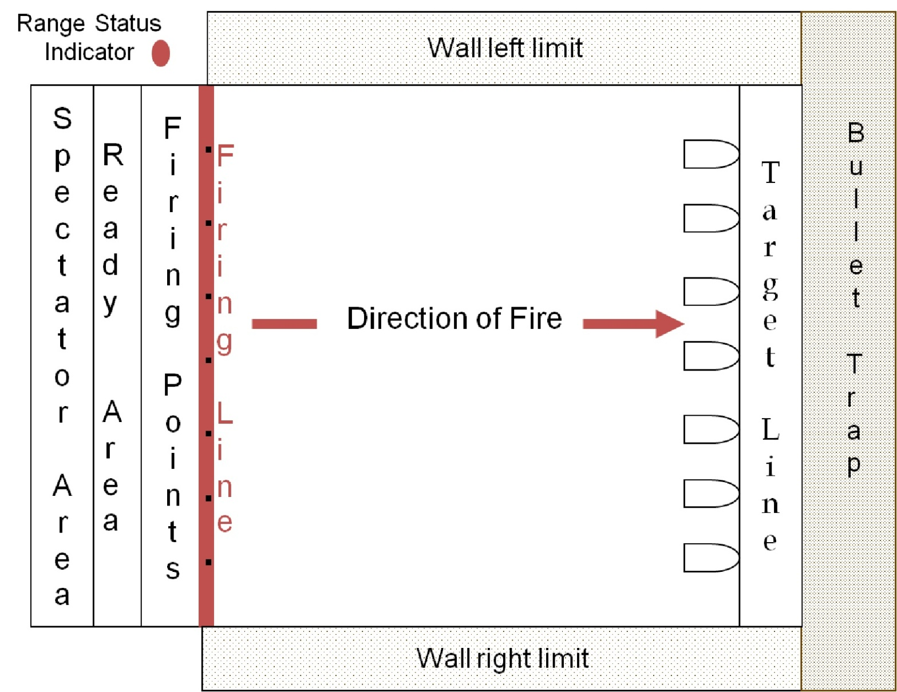
Step 2: Range Layout & Limits - Indoor
Slide IV-5
Lesson I
Lesson II
Lesson III
Lesson IV
Lesson V
Lesson VI
Lesson VII
Notes:
Step 2: Range Layouts & Limits – Indoor
2Min. Cumulative Time: 17 Min.
Ask: What areas should be included in the range safety briefing?
Emphasize that at, a minimum, the range safety briefing should address the backstop, firing line, ready area, and special information such as the position at which targets may be hung, e.g., eye level, and that dry firing is only permitted at the firing line.
State that information on range characteristics and design may be found in NRA Competition Rule Books and the NRA Range Source Book, and should be included in the range SOPs. Common aspects of indoor range layout are displayed above and include:
• Range Status indicator--Flag or light at the back of the firing line shows when the range is in use.
• Spectator Area--An area often located behind the ready line so visitors and spectators will not disrupt range operations.
• Ready Area (Preparation Area) --Where shooters are allowed to store and prepare equipment while awaiting their tum to fire. No handling of firearms.
• Firing Point--The area for the shooter immediately behind the firing line. Firing points are approximately four to six feet wide and are numbered to correspond with the targets.
• Firing Line--The line immediately in front of the firing points and parallel to the line of targets. Ranges are measured from this line to the face of the targets when targets are hung in their proper positions in front of the backstop. No one may step forward of the firing line unless under the guidance and with the permission of the RSO.
• Target Numbers--Displayed at the target line on alternating backgrounds of contrasting colors, target numbers correspond to the firing point numbers and are placed so that they remain visible from the firing line when targets are concealed or displayed.
• Backstop--A device constructed to stop or redirect projectiles. A similar device is the bullet trap, which is designed to capture a bullet and bullet fragments.

Slide 40
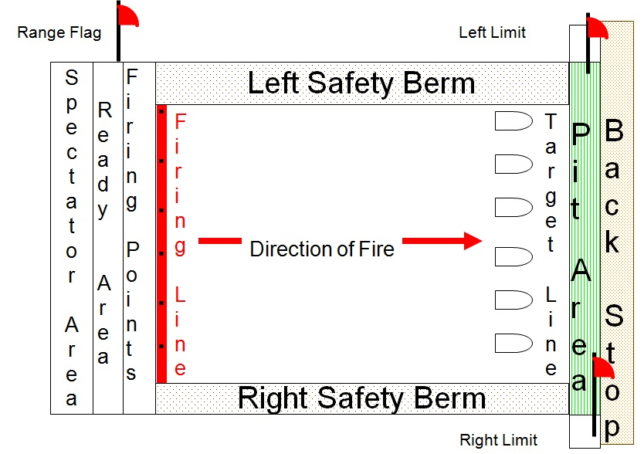
Step 2: Range Layout & Limits - Outdoor
Slide IV-6
Lesson I
Lesson II
Lesson III
Lesson IV
Lesson V
Lesson VI
Lesson VII
Notes:
Step 2: Range Limits & Limits – Outdoor
2 Min. Cumulative Time: 19 Min.
Ask: What additional areas does an outdoor range have compared to an indoor range?
State that information on range characteristics and design may be found in NRA Competition Rule Books and the NRA Range Source Book, and should be included in the range SOP.
Explain that an outdoor range is similar to an indoor range and has a few additional areas:
• Range Status Indicator--Flag or light at the back of the firing line shows when the range is in use.
• Direct Fire Zone--Established according to the relationship of the shooting position and target position. For example, competition smallbore rifle, pistol, high power rifle, sport rifle, etc. are set up on a one-to• one basis (one target to each firing point).
• Right and Left Range Limits--Identified by range flags or markers. (On military ranges, the left marker is white and the right marker is red and white.)
• Safety Berms and Side Berms--Embankments used for restricting projectiles to a given area, and also used as dividing walls between ranges.
• Pit Area--Often used on a range of 200 yards or longer, this area is protected by a backstop or natural and man-made barriers. It may be above or below ground, and provides a position for range personnel from which targets may be pulled, scored, and exposed to the shooter.
• Impact Area--The area in a backstop or bullet trap directly behind the target where projectiles are expected to impact. Impact area may also be an area downrange on an outdoor range where bullets and/or projectiles will impact if not captured in a backstop. All projectiles fired must be contained on the range
facility.
• Baffles (not shown) --Barriers used to contain projectiles and reduce, redirect, or suppress sound waves. Baffles may be placed overhead, alongside, or at ground level to restrict or interrupt errant shots. All projectiles fired must be contained on the range facility.

Slide 41
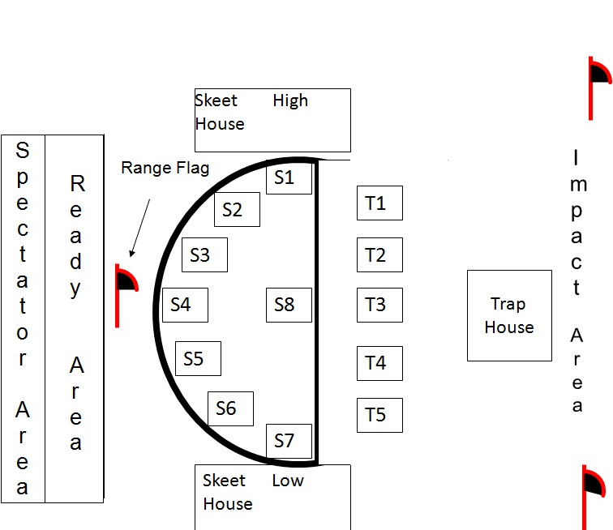
Step 2: Range Layout & Limits - Outdoor
Slide IV-7
Lesson I
Lesson II
Lesson III
Lesson IV
Lesson V
Lesson VI
Lesson VII
Notes:
Step 2: Range Layout & Limits – Outdoor
2Min. Cumulative Time: 21 Min.
Ask: What area should be included in the range safety briefing for a shotgun range?
State that information on range design and characteristics can be found in National Skeet Shooting Association and Amateur Trapshooting Association rule books and the NRA Range Source Book, and should be included in the range SOP.
Explain that shotgun ranges are referred to as fields, not ranges.
• Range Status Indicator--Flag or other prominent indicator that shows when the field is not in use.
• Direct Fire Zone--Established according to the relationship of the shooting station and the target's line of flight.
• Shooting Stations-•
•Skeet: There are eight stations on a skeet field. Seven are arranged in a semi-circle with one midway between Sl and S7 (see S1-S8 above).
•Trap: A trap field has five stations (see Tl-T8 above). The front of each station is 16 yards from the opening of the trap house and extends back to 27 yards in one-yard increments. All shooters stand at 16 yards for singles and doubles events. The longer distances come into play in the handicap events. The better the shooter, the greater the distance from the trap house. For safety reasons shooters, should not be more than two yards forward or back of the adjacent shooter.
• Right and Left Range Limits--Identified by range flags or markers.
• Skeet High and Low Houses--The structures from which the clay targets are launched for skeet.
• Trap House--The structure from which clay targets are launched for trap. Generally, access to the structure containing operating trap machines is restricted to authorized persons only.
• Impact Area--The area where the shot pellets fall to the ground. The area must be large enough to contain all shot pellets fired on the facility

Slide 42
Step 3: Range Safety Rules
Slide IV-8
Range SOP guide the RSOs and state all “must know” information.
NRA Gun Safety Rules
  Three Fundamental Rules for Safe Gun Handling
  Eight Rules for Using or Storing a Gun
General Range Rules
Site-Specific Range Rules
Administrative Rules
Lesson I
Lesson II
Lesson III
Lesson IV
Lesson V
Lesson VI
Lesson VII
Notes:
Step 3: Range Safety Rules
3Min. Cumulative Time: 24 Min.
State that there are four general categories of range rules: NRA gun safety rules, general range rules, site specific range rules, and administrative rules. Provide a brief overview and explanation of each.
NRA Gun Safety Rules:
• Include "Fundamental Rules for Safe Gun Handling" and "Rules for Using or Storing a Gun."
• Form the foundation for shooting range rules.
General Range Rules:
• Apply to all shooting ranges. Published in the NRA Range Source Book.
Site-Specific Range Rules:
• Created for the particular range.
• Tailored to meet site-specific needs or limitations, e.g., no full metal-jacket ammunition, full metal-jacket ammunition allowed, blackpowder guns allowed, tracer ammunition prohibited, etc.
• Site-specific range rules and procedures appear in the NRA Range Source Book and in NRA Rule Books, e.g., range commands and procedures are found in Rule 10.7.
Administrative Rules:
• Provide administrative and policy guidance for a particular range, e.g., parking.

Slide 43
Step 4: Firing Line Commands
Slide IV-9
Lesson I
Lesson II
Lesson III
Lesson IV
Lesson V
Lesson VI
Lesson VII
What commands can be issued by anyone?
What are the advantages of using standard range commands?
What are the characteristics of effective range commands?
Notes:
Step 4: Firing Line Commands
3 Min. Cumulative Time: 27 Min.
Ask: What avenues are used to educate range users on range commands?
• Range commands should be specified in the range SOPs for the particular types of shooting events conducted on the range. They should also be posted on bulletin boards and distributed to range users. Standard range commands are explained during the range safety briefing. In addition, formal competitions are conducted using commands printed in the respective NRA Competition Rule Books.
Ask: What range commands may be issued by shooters?
• "Cease firing or Stop" and "Misfire " (for muzzleloading guns)
Ask: What information do range commands convey to a shooter?
• Range commands tell the shooter what to do, how to do it, where to do it, when to do it, and the time that it will take.
Ask: What are the characteristics of effective range commands?
• Effective range commands are short, easily understood, heard, and require immediate response.
Ask: Why is it important to use standard range commands?
• Standard range commands facilitate shooter understanding and safety.
Ask: What standard range commands should be used?
• Informal ranges may function quite well with minimal commands, such as "Load," "Commence firing," "Cease firing," and "Is the line safe ...." Formal shooting events and ranges with a large number of shooters will benefit from using more detailed standard range commands.

Slide 44
Commands
Slide IV-10
Lesson I
Lesson II
Lesson III
Lesson IV
Lesson V
Lesson VI
Lesson VII
Tower Discipline
Cadence of Commands
Notes:
Commands
3 Min. Cumulative Time: 30 Min.
Ask: Why is it important for the RSO to minimize range announcements and avoid unnecessary "tower talking?"
• Excessive "tower talking" distracts and confuses shooters. "Tower talk" should be restricted to commands needed to safely and efficiently conduct the shooting event.
Ask: Why is it extremely important to maintain a three-second cadence during the sequence: "Ready on the right!", "Ready on the left!", and “Ready on the firing line!"
• This cadence enables the competitive shooter to time his or her first shot to the exposure of the targets and take advantage of the full shooting time limit.

Slide 45
Standard Range Commands
Slide IV-11
Lesson I
Lesson II
Lesson III
Lesson IV
Lesson V
Lesson VI
Lesson VII
“As you were”
“Carry on”
“Relay No. ____, Match No. ____”
“The preparation period starts now”
“The preparation period has ended”
“Snap caps”
“Load”
“Make ready”
Notes:
Standard Range Commands
2Min. Cumulative Time: 32 Min. Ask the students for the meaning of each standard range command.
Strive to have students generate the appropriate answers and discussion. If the correct answers are not given, ask additional questions to guide responses. During discussion, highlight the main points provided below.
• "As you were" means to disregard the command just given.
• "Carry on" means to proceed with whatever was being done before some interruption occurred.
• "Relay No. _, Match No._ (or naming the match), on the firing line" means shooters are to move to their firing points.
• "The preparation period starts now" means shooters may occupy their firing points, prepare, and dry-fire at the targets. This period generally lasts three minutes for competition shooting.
• "The preparation period has ended" means the end of the preparation period.
• "Snap caps"(muzzleloading firearms only) directs the shooter to move to the firing line, affix a primer cap, point the firearm downrange, and "snap" the cap to ensure that the flash hole is open and that the barrel is free of any material capable of causing a hangfire.
• "Load" means shooters are allowed to load the authorized number of cartridges and prepare for the shooting event. (This command may be prefaced with the number of cartridges to be fired and the time available.)
• "Make ready “means shooters work the actions to chamber cartridges or projectiles for the shooting event.

Slide 46
Standard Range Commands (Continued)
Slide IV-12
“Is the line ready?”
“Not ready on target ____”
“The line is ready”
“Ready on the right…Ready on the left…Ready on the firing line”
“Commence firing” or “Start”
“Pull”
“Misfire on target . . .”
Lesson I
Lesson II
Lesson III
Lesson IV
Lesson V
Lesson VI
Lesson VII
Notes:
Standard Range Commands (Continued)
4 Min. Cumulative Time: 36 Min.
Ask the students for the meaning of each standard range command.
• "ls the line ready?" is announced by the RSO so that a shooter who experiences a problem may raise an arm and call "Not ready on target (1n the event of a "not ready" signal, the RSO would announce "The line is not ready," investigate and assist the shooter, or remove the shooter from the firing line.)
• "The line is ready" is announced when the RSO observes that the line is ready, or after a difficulty has been corrected.
• "Ready on the right!" "Ready on the left!," "Ready on the firing line!" is the sequence of preparatory commands announced by the RSO with a three-second interval between commands. This sequence gives shooters their last chance to signal "Not ready." "Ready on the firing line!" means that the range is ready and that targets will be exposed in approximately three seconds.
• "Commence firing!" is announced about three seconds after "Ready on the firing line!" and informs shooters that they may begin shooting. This command may be signaled verbally, by a whistle, light system, or horn blast, or by moving the targets into view.
• "Pull!" is used on shotgun fields by the shooters to signal for release of the clay target they are going to shoot.
• "Misfire" is announced by a shooter to inform the RSO and other shooters that a gun failed to fire
and a hazardous condition may exist (especially with muzzleloading guns). Due to the possibility of a hangfire (a delay in the ignition of a cartridge), the shooter keeps the gun pointed downrange and waits at least 30 seconds for modem firearms, or two minutes for muzzleloading guns, prior to correcting the malfunction.

Slide 47
Standard Range Commands (Continued)
Slide IV-13
Lesson I
Lesson II
Lesson III
Lesson IV
Lesson V
Lesson VI
Lesson VII
“Cease firing!” or “Stop!”
“Unload”
“Show Clear”
“Is the line clear on the right?... on the left?”
“The line is clear”
“Move out of position…”
“Go forward, score targets, and paste”
“Police your firing point”
Notes:
Standard Range Commands (Continued)
3 Min. Cumulative Time: 39 Min.
Ask the students for the meaning of each standard range command.
• "Cease firing" or "Stop!" is announced by the RSO when time expires or at any other time that firing is to cease. The RSO notifies shooters to stop firing immediately, remain in position, and await further instructions. "Cease firing" or "Stop" may be signaled verbally, by a whistle or horn blast, or by moving
the targets out of view. Additional commands to unload, open the action, and bench or ground the gun may follow. During range safety briefings, the RSO should emphasize that "Cease firing" or "Stop" can be announced by anyone observing an unsafe condition.
• "Unload “directs the shooter to unload the gun.
• "Show clear" requires the shooter to show that his gun is clear of all ammunition. The shooter unloads the gun and opens the action for inspection by a second person, who confirms that the gun is unloaded.
• "Is the line clear on the right?", "Is the line clear on the left?" signals that line officers or the RSO check that all guns are unloaded with the actions open and chambers empty. Upon verifying (or receiving signals) that all guns are unloaded, the RSO announces: "The line is clear!" Additional commands may follow.
• "Move out of position and remove your equipment from the firing line “authorizes shooters to remove their gear.
• "Go forward, score targets, and paste" or "Change" means shooters must go forward of the line to change targets. The RSO ensures all guns are unloaded and grounded or benched before allowing anyone to go forward of the firing line. While shooters are scoring or changing targets, no guns are handled. When all shooters have returned and no personnel are downrange, the RSO states: "Range is clear, you may handle your guns." This command informs shooters they may prepare for the next course of fire or get ready to depart the firing line.
• "Police your firing point" means that shooters should pick up fired cartridge cases and clean their firing points. The RSO and shooters must follow the SOPs because indoor ranges often
have specific policies on handling cartridge cases and cleaning firing points

Slide 48
Step 5: Emergency Procedures
Slide IV-14
Establish procedures for everyone to follow in case of an emergency.
  Take charge of the situation.
  Call for help, if required.
  Render aid, within scope of training.
  Direct help to location.
  Take notes (Reports).
Lesson I
Lesson II
Lesson III
Lesson IV
Lesson V
Lesson VI
Lesson VII
Notes:
Step 5: Emergency Procedures
4Min. Cumulative Time: 43 Min.
Ask: Why is it important to include emergency procedures in the range safety briefing?
• The RSO needs to familiarize range users with emergency procedures because users may be called on
to render aid, call for help, direct the emergency vehicle to the person needing help, and document important information (time, activities, etc.).
• The RSO may have become incapacitated, and range users need to know how to conduct the emergency procedures.
Note: 1f your range is staffed with enough personal to conduct emergency procedures, you may opt not to give the emergency procedures portion of the Range Safety Briefing. If you opt not to conduct the emergency procedure portion, make sure your SOP states what is to be given during the Range Safety Briefing.

Slide 49
Range Safety Briefing Exercise
Slide IV-15
Conduct on or within view of the range.
Stand at a location that supports the briefing (e.g. near posters, firing line, equipment).
Arrange users in a semi-circle.
Ask users to read rules and answer questions.
Use posters and reference handouts.
Use IDEP equipment demonstrations.
  Introduce, Demonstrate, Explain and Practice
Lesson I
Lesson II
Lesson III
Lesson IV
Lesson V
Lesson VI
Lesson VII
Notes:
Range Safety Briefing Exercise
•
6 Min. for Slide and 30 Min.* for Exercise. Cumulative Time: 79 Min.
*Note: Divide the class into five teams and assign each team one of the range safety briefing steps. The estimated time is based on each of the five presentations taking one to three minutes per presentation, and a quick one-minute discussion after each presentation. Allow about I minute for presentations and review discussions. Remember that any time adjustments will change the cumulative time projections for the remainder of the lesson.
Inform students that during this exercise, they will work as a team and each member will give one part of the range safety briefing. They will have 15 minutes to prepare. Remind them to present must-know information and to keep it simple and short.
Distribute copies of the sample range SOPs. (Appendix)
Emphasize that RSOs should give thorough briefings. Explain that in addition to the verbal briefing, range users should receive shooting range rules, brochures, and other written materials that highlight key points. 1f possible, the RSO should use wall charts and range rules as visual aids.
Emphasize that the RSO should involve range users by having them read rules from handouts or visual aids. They should also answer questions to reinforce understanding.
Explain to students that they will be role-playing as range users while one student conducts the range safety briefing as the RSO. 1f needed, a student may be enlisted as an RSO assistant.
Direct students to observe each briefing closely because they will be asked to comment on them.
Observe carefully and keep notes because briefings will be used to recommend students for NRA Range
Safety Officer Certification.
Conduct a discussion at the completion of each briefing to provide positive reinforcement and suggestions for improvement. Solicit input from students to provide guidance and motivation. Discussion should last approximately three minutes per student.

Slide 50
Sample Range Safety Briefing
Slide IV-16
Lesson I
Lesson II
Lesson III
Lesson IV
Lesson V
Lesson VI
Lesson VII
Standard Range Safety Briefing Steps:
Purpose of the Shooting Event
Range Layout and Limits
Range Safety Rules
Firing Line Commands
Emergency Procedures
Notes:
Sample Range Safety Briefing
1. Purpose of the Shooting Event: Grouping and zeroing
2. Range Layout and Limits: Use a drawing from classroom exercise.
1. Ready area 4. Impact area
2. Firing line 5. Gun to target line (target and firing line numbers)
3. Target area 6. Left and right range limits
3. Range Safety Rules: Use wall poster or front of NRA Rule Books.
• NRA Gun Safety Rules
Rules for Safe Gun Handling:
-ALWAYS keep the gun pointed in a safe direction.
-ALWAYS keep your finger off the trigger until ready to shoot.
- ALWAYS keep the gun unloaded until ready to use.
Rules for Safe Usage:
- Know your target and what is beyond.
- Be sure the gun is safe to operate.
-Know how to use the gun safely.
-Use only the correct ammunition for your gun.
- Wear eye and ear protection as appropriate.
- Never use alcohol or drugs before or while shooting.
• General Range Rules: Check SOPs.
• Site-Specific Rules: Check SOPs of the range you are using.
• Administrative Rules: Check SOPs of the range you are using.
4. Firing Line Commands: Explain the appropriate action for each command.
5. Emergency Procedures:
-Take charge of the situation.
- Call for help.
- Render aid.
- Direct medical help to location. Take notes (Reports).

Slide 51
Lesson IV: Review
Slide IV-17
Learning Objectives:
Upon completion of this lesson, you should be able to:
Explain the purpose of a range safety briefing
Conduct a range safety briefing.
Explain the purpose of a range safety briefing.
List the topics are covered in a range safety briefing.
Where the RSO stand when giving the briefing.
What are your questions?
Lesson I
Lesson II
Lesson III
Lesson IV
Lesson V
Lesson VI
Lesson VII
Notes:
Lesson IV: Conclusion
5 Min. Cumulative Time: 84 Min.
Ask: What is the purpose of a range safety briefing?
• The range safety briefing prepares shooters to safely and efficiently participate in a particular shooting event on a specific range.
Ask: What main topics are covered in a range safety briefing?
• Purpose of the Shooting Event
• Range Layout and Limits
• Range Safety Rules
• Firing Line Commands
• Emergency Procedures
Note: Student text contains the answers to these questions:
Where and when should the range safety briefing be conducted?
What should range users be given prior to the briefing?
Where should the RSO stand?
How long should the range safety briefing last?
What rules and policies should be followed if guns are used during the briefing?

Slide 52
Lesson V: Preview
Slide IV-18
In Lesson V you will learn:
Purpose of Emergency Response Procedures.
Steps taken during an emergency.
Conducting emergency response plans.
What are your questions?
Lesson I
Lesson II
Lesson III
Lesson IV
Lesson V
Lesson VI
Lesson VII
Notes:
Lesson V: Preview
1 Min. Cumulative Time: 85 Min.
Preview the next lesson by stating the topics that students will learn. Announce the amount of time allotted for the break and what time the next lesson will begin

Slide 53
Lesson V: Emergency Procedures
Slide V-1
Learning Objectives:
Upon completion of this lesson, you should be able to:
Explain the purpose of having emergency procedures.
Identify the steps to take during an emergency.
Conduct an emergency exercise.
Lesson I
Lesson II
Lesson III
Lesson IV
Lesson V
Lesson VI
Lesson VII
Notes:
Lesson V: Emergency Procedures
2Min. Cumulative Time: 2 Min
Explain why each objective is important.
Learning Objectives:
Upon completion of this lesson, you should be able to:
Explain the purpose of having emergency procedures.
Identify the steps to take during an emergency.
Conduct an emergency exercise.

Slide 54
Purpose of Emergency Procedures
Slide V-2
Lesson I
Lesson II
Lesson III
Lesson IV
Lesson V
Lesson VI
Lesson VII
Minimize confusion during an emergency.
Save time responding to an emergency.
May reduce insurance costs.
Notes:
Purpose of Emergency Procedures
2Min. Cumulative Time: 2 Min.
Explain why each objective is important.
Minimize confusion during an emergency.
Save time responding to an emergency.
May reduce insurance costs.
Why should a range have emergency procedures?
A well rehearsed emergency procedure will result in less confusion, better response time, and proper care for the ill or injured persons.
Reduced insurance premiums may be available.
========================
LEARNING OBJECTIVES: Upon completion of this lesson, students should be able to:
1. Explain the purpose of having emergency procedures.
2. Identify the steps to take during an emergency.
3. Conduct an emergency exercise.
Length: 60 Minutes
Facility: Classroom
Training Materials:
• NRA Basic Range Safety Officer Course Student Study Guide (one per student)
• Notepads and pencils (one per student)
• Viewgraphs
• Range first-aid kit
• Phone or radio
• Training aids as appropriate: chalk, eraser, blackboard, flipchart, easel, markers, overhead projector, bulbs, screen, etc.
Reference:
American Red Cross Standard First-Aid Book

Slide 55
Emergency Procedures
Slide V-3
Lesson I
Lesson II
Lesson III
Lesson IV
Lesson V
Lesson VI
Lesson VII
Standardize steps and the sequence in which they are performed.
Take charge of the situation.
Call for help, if required.
Render aid, within scope of training.
Direct medical help to location.
Take notes (Reports).
Notes:
Emergency Procedures
3 Min. Cumulative Time: 8 Min.
Ask: How many of you have emergency procedures at your range?
Ask: What are the steps in your emergency procedure? What is the order of the steps? Why?
Ask: How often are emergency procedure drills conducted to ensure all RSOs are comfortable in what to do and how to do it?
Make the Point: It’s critical that your range has emergency procedures and that you know them!

Slide 56
Step 1: Take Charge of Situation
Slide V-4
Cease firing, unload, and stay in place.
Evaluate the situation.
  Minor or major injury?
  If major, call for help immediately
Designate helpers if necessary.
  Call for help, if required.
  Render aid, within scope of training.
  Direct medical help to location.
  Take notes (Reports).
Lesson I
Lesson II
Lesson III
Lesson IV
Lesson V
Lesson VI
Lesson VII
Notes:
Step 1: Take Charge of Situation
5Min. Cumulative Time: 13 Min.
Ask: What actions do you take to stay in control of the situation?
Discuss the points on the slide.
The RSO must be in charge during an emergency. The RSO is the only person trained to conduct the complete emergency procedure. Should an incident occur:
1. Command: "Cease fire, cease fire. Unload and stay in place." Move to the scene.
2. Evaluate the seriousness of the injury.
MINOR INJURY (cut finger, scraped knee, etc.):
• Render aid within the scope of their training.
• Direct person to seek appropriate medical attention.
• Commence firing again.
• Complete report for the record.
MAJOR INJURY (heart attack, broken leg, gunshot, etc.):
• Task someone to call emergency numbers.
• Render aid within the scope of their training.
• Task someone to direct the emergency vehicle to the incident.
• Task someone to record the time and actions taken during the emergency.
• Task all witnesses to write down what they saw.
• Continue to provide aid until EMS arrives.
• Complete report for the record

Slide 57
Step 2: Call for Help
Slide V-5
Checklist on how to make the call.
Have phone numbers or radio emergency channel on hand.
Give the dispatcher necessary information:
  Location
  Phone number from where the call is being made
  Your name
  What happened
  How many people injured; condition of injured
  Location of person who will direct help to the scene
Lesson I
Lesson II
Lesson III
Lesson IV
Lesson V
Lesson VI
Lesson VII
Notes:
Step 2: Call for Help
5 Min. Cumulative Time: 23 Min.
Ask: Has anyone ever had to make a call for help?
(Ask students to share their experiences with the class.)
Walk the class through the steps in making the call for help (Appendix 5).

Slide 58
Step 3: Render Aid
Slide V-6
Training and Equipment
  First-aid training & CPR are highly recommended.
  Contact doctor’s office for first-aid kit requirements.
Good Samaritan Law (Refer to Connecticut OLR Update 09/2018 Handout
Aid
  Determine level of care. (Call for help or treat?)
Gather information for emergency phone call.
Lesson I
Lesson II
Lesson III
Lesson IV
Lesson V
Lesson VI
Lesson VII
Notes:
Step 3: Render Aid
5 Min. Cumulative Time: 18 Min.
Ask: Is anyone EMS qualified? (If so, ask them how much training they have.)
Point out:
• It is highly recommended that all RSOs be trained in basic first aid and cardiopulmonary resuscitation (CPR), but that is a determination which must be made by range management. The Range SOP should state what type of emergency training is required to be an RSO.
• NRA highly recommends knowing basic first aid and CPR. The more medical training you have, the better. You can never be over qualified in medical training.
• Let medical professionals tell you what you need in a first-aid kit or trauma kit. Most RSOs are not qualified to determine what is needed.
Ask: What is the Good Samaritan law?
• A law that protects you when you help in an emergency. The key words in the Good Samaritan law are that you act in a reasonable and prudent manner.
Ask: What is meant by reasonable and prudent?
• Examples:
-- Move an injured person only if his or her life is endangered.
-- Ask the injured person for permission before giving aid.
-- Call for professional help.
Explain: Range management should write into the range SOP to what extent injuries can be treated and what records must be maintained

Slide 59
Step 4: Direct Medical Help to Location
Slide V-7
Lesson I
Lesson II
Lesson III
Lesson IV
Lesson V
Lesson VI
Lesson VII
Position one or more persons to direct the emergency vehicle:
  On main road to entrance of the facility.
  On road to range.
  Outside the building.
Notes:
Step 4: Direct Medical Help to Location
3Min. Cumulative Time: 26 Min.
Ask: Where would you post your vehicle director on your range? How many would you use
Position one or more persons to direct the emergency vehicle:
On main road to entrance of the facility.
On road to range.
Outside the building.
How many would you use?

Slide 60
Step 5: Take Notes (Report)
Slide V-8
Lesson I
Lesson II
Lesson III
Lesson IV
Lesson V
Lesson VI
Lesson VII
Take notes on the times actions were taken.
  Smartphones give you access to a camera.
Get statements from witnesses.
Complete required SOP form.
Notify authorities if necessary.
Sample report in the sample SOP – Appendix 5
Notes:
Step 5: Take Notes (Report)
4Min. Cumulative Time: 30 Min.
Ask: How can you protect your gun club from a lawsuit?
• The range SOP must require that reports be filed on all incidents.
Explain:
• A report for the record needs to be filed with all the appropriate activities on all incidents, no matter how small. The SOP may contain a list of persons or activities to receive incident reports. A minor cut or fall could develop into a lawsuit in today's society

Slide 61
Emergency Drill Exercise
Slide V-9
Lesson I
Lesson II
Lesson III
Lesson IV
Lesson V
Lesson VI
Lesson VII
Conduct an emergency exercise.
Use these steps to organize your response:
  Take charge of the situation (RSO).
  Call for help, if required (runner, phone, and radio).
  Render aid (first aid and CPR).
  Direct medical help to location (range personnel or runner).
  Take notes (range personnel or others).
Notes:
Emergency Drill Exercise
3 Min. for Slide; 5 Min. to Organize; 18 Min. for Role-Playing. Cumulative Time: 56 Min.
Note: Divide the class into several teams and assign each team one of the scenarios below. Give students, five minutes to organize their plans. Assign one or more steps of the emergency procedures to each student to role-play. The estimated time is based on the presentation of three scenarios, each presentation taking about five minutes with a quick one-minute discussion after each presentation. Allow about 18 minutes for presentations and review discussions. Remember that any time adjustments will change the cumulative time projections for the remainder of the lesson.
Each scenario should be as different as possible. All scenarios start with the RSO giving the commands to commence fire. The RSO steps out of the classroom while the instructor explains the scenario to the other students. The RSO should not know the type of incident planned or who will be the injured person.
Rarely does a major incident occur on the firing line, but for training purposes, conduct these scenarios:
• Broken leg (compound fracture) from a fall in the pit.
• Wound in the leg from a ricochet in the pit.
• Heart attack on the firing line (person is not breathing).
• Shot in the leg when holstering a handgun.
• Cut thumb from a semi-automatic pistol.
• Staple in the hand on the pistol range.

Slide 62
Lesson V: Review
Slide V-10
Learning Objectives:
As a result of this lesson, you should be able to:
Explain the purpose of having emergency procedures.
Identify the steps to take during an emergency.
Conduct an emergency exercise.
What are your questions?
Lesson I
Lesson II
Lesson III
Lesson IV
Lesson V
Lesson VI
Lesson VII
Notes:
Lesson V: Review
3Min. Cumulative Time: 59 Min.
Ask: What is the purpose of having emergency procedures?
• To save lives.
Ask: How many steps are needed in an emergency procedure?
• The number of steps and sequence is secondary to having a written emergency procedure.
Ask: What can RSOs do to prepare themselves for an emergency?
• Mentally visualize going through a drill.
• Make a wallet-size card with emergency procedures on it for reference

Slide 63
Lesson VI: Preview
Slide V-11
Lesson I
Lesson II
Lesson III
Lesson IV
Lesson V
Lesson VI
Lesson VII
In lesson VI; you will be learning how to:
Clearing gun stoppages and malfunctions.
What are your questions?
Notes:
Lesson VI: Preview
1 Min. Cumulative Time: 60 Min.
Preview the next lesson by stating the topics that students will learn. Announce the amount of time allotted for the break and what time the next lesson will begin.

Slide 64
Lesson VI: Gun Stoppages & Malfunctions
Slide VI-1
Learning Objectives
Upon completion of this lesson, you should be able to:
Explain the difference between a stoppage and a malfunction.
Demonstrate how to safely take a gun from a shooter.
Demonstrate how to clear common stoppages.
No Live Ammunition, Percussion Caps, Pellets, BBs or Propellants in the Classroom!
Use only dummy cartridges or dummy shot shells for classroom demonstrations.
Lesson I
Lesson II
Lesson III
Lesson IV
Lesson V
Lesson VI
Lesson VII
Notes:
Lesson VI: Gun Stoppages & Malfunctions
2Min. Cumulative Time: 2 Min.
Ask: Why should the Range Safety Officer (RSO) know the difference between a stoppage and a malfunction?
• To determine what caused the firearm to stop operating and inform the shooter if it will happen again.
Ask: How many of you have a system that you use to control a jammed gun and clear it?
• You will learn a simple system for taking control of a gun, and have the opportunity to clear several different firearms.
====================
LEARNING OBJECTIVES: Upon completion of this lesson, students should be able to:
1. Explain the difference between a stoppage and a malfunction.
2. Demonstrate how to safely take a gun from a shooter.
3. Demonstrate how to clear common stoppages.
Length: 150 Minutes
Facility: Classroom
Training Materials:
• NRA Basic Range Safety Officer Course Student Study Guide (one per student)
• Notepads and pencils (one per student)
• Viewgraphs
• Long guns (six action types)
• Pistols (revolvers and semi-automatics)
• Muzzleloading firearms (flintlock or percussion)
• Air guns (rifle or pistol), including BB guns (rifle or pistol)
• Dummy ammunition (Use only dummy cartridges or dummy shotshells for classroom demonstrations.)
• Training aids as appropriate: chalk, eraser, blackboard, flipchart, easel, markers, overhead projector, bulbs, screen, etc.
References:
NRA Handbooks:
NRA Guide: The Basics of Rifle Shooting
NRA Guide: The Basics of Pistol Shooting
The Basics of Shotgun Shooting
NRA Guide: Home Firearm Safety
NRA How to Series: Muzzleloading
No Live Ammunition, Percussion Caps, Propellants, or Projectiles in the Classroom!

Slide 65
What is a Stoppage?
Slide VI-2
A stoppage is an unintentional interruption in the operational cycle of a gun, which stops the gun from operating properly.
Stoppages can be cleared quickly, which returns the gun back to operational condition.
Examples of stoppages:
  The bolt fails to lock a cartridge into position.
  A stove-pipe in a semi-automatic pistol.
  A double-feed.
Lesson I
Lesson II
Lesson III
Lesson IV
Lesson V
Lesson VI
Lesson VII
Notes:
Stoppage
1 Min. Cumulative Time: 3 Min.
Ask: What is a stoppage?
• A stoppage is an unintentional interruption in the operational cycle of a firearm, that locks up the action keeping it from functioning properly. Stoppages can be cleared from the firearm quickly, which returns it back to an operational condition.
Ask: Can anyone give me an example of a stoppage?
• Failure to extract the case from the chamber
• Failure to feed the cartridge into the chamber
• Stove-pipe failure to eject (empty case trapped between slide and barrel

Slide 66
Gun Stoppage
Slide VI-3
Cycle of operation (eight (8) steps)
Feeding
Chambering
Locking
Firing
Unlocking
Extracting
Ejecting
Cocking
Lesson I
Lesson II
Lesson III
Lesson IV
Lesson V
Lesson VI
Lesson VII
Notes:
Gun Stoppage
3 Min. Cumulative Time: 6 Min.
Ask: What are the steps of the cycle of operation of a gun?
Quickly explain each step of the cycle of operation.
Note: These are the eight basic steps of the cycle of operation. All guns do not follow these steps in exact order. For example, revolvers do not extract and eject between shots. Extracting and ejecting is done when the shooter unloads the revolver. These are the eight basic steps of the cycle of operation. All guns do not follow these steps in exact order. For example, revolvers do not extract and eject between shots. Extracting and ejecting is done when the shooter unloads the revolver.

Slide 67
What is a Malfunction?
Slide VI-4
A malfunction is a failure of a gun or ammunition to function as designed or fire satisfactorily.
Two categories of malfunctions:
  Gun malfunction
    Require the gun to be repaired to make it function properly.
    Example: A broken sear that causes the pistol to fire all rounds in the magazine.
  Ammunition malfunction
    Example: A misfire.
Lesson I
Lesson II
Lesson III
Lesson IV
Lesson V
Lesson VI
Lesson VII
Notes:
What is a Malfunction?
3Min. Cumulative Time: 9 Min.
Ask: What is a malfunction?
• A malfunction is a failure of a gun or ammunition to function as designed or fire satisfactorily.
Ask: What are the two categories of malfunctions?
• Gun malfunction. Malfunctions require the gun to be repaired to restore it to a properly functioning gun.
• Ammunition or projectile malfunction.
Ask students for examples of gun malfunctions.
Give this example of a malfunction:
The gun goes "click" when the trigger is pulled.
Ask: What is the problem?
• Gun malfunction? Broken firing pin or no cartridge in the chamber?
• Ammunition malfunction? Cartridge malfunctioned?
Ask: What action should be taken?
• First wait 30 seconds while keeping the gun pointed downrange with your finger off the trigger.
• Then remove the cartridge and check the primer for firing pin indentation.
Ask: Give an example of an ammunition malfunction.
• Misfire, hangfire, and squib load.
Explain that ammunition malfunctions will be covered in detail on the next slide.
State:
• All guns must be unloaded before leaving the firing line.
• If a gun is found to have a malfunction, it should be taken to a competent gunsmith or returned to the manufacturer for repair

Slide 68
Ammunition Malfunctions
Slide VI-5
Lesson I
Lesson II
Lesson III
Lesson IV
Lesson V
Lesson VI
Lesson VII
Misfire
  A failure of a cartridge to fire after the primer has been struck by the firing pin.
Hangfire
  A perceptible delay in the ignition of a cartridge after the primer has been struck by the firing pin.
Squib load
  A cartridge which develops less than normal pressure or velocity after the ignition of the cartridge.
Notes:
Ammunition Malfunctions
5Min. Cumulative Time: 14 Min.
Ask: What is a misfire?
• The gun does nothing when the trigger is pulled. You hear only the click of the firing pin striking the primer.
Ask: What is a hangfire?
• A perceptible delay in the ignition of a cartridge after the primer has been struck by the firing pin.
Ask: What is a squib load?
• Less than normal pressure or velocity develops after ignition of the cartridge.
Ask: What is the procedure for handling misfires or hangfires?
• Keep the gun pointed downrange.
• Wait at least 30 seconds in case it is a hangfire; with muzzleloaders wait at least two minutes.
Ask: What is the procedure for handling squib loads?
• Stop firing immediately; keep the gun pointed downrange; unload the gun. Make sure the chamber is empty and insert a cleaning rod down the barrel from the chamber end of the barrel, if possible, to check that the bullet is still not in the barrel.
Ask: What should the RSO do if he sees a shooter with an ammunition malfunction?
• Nothing. Wait and see! The RSO should watch the shooter and respond to what he or she does. The shooter should follow the instructions given during the range safety briefing. But if the shooter starts any unsafe act, such as to look down the barrel, the RSO must be prepared to step in and correct the situation.
• Be in control and in a low but firm voice say: STOP! POINT THE MUZZLE DOWNRANGE! Only as a last resort would you grab the shooter's hand to control the gun. You could make the ----, situation worse. Instruct the shooter to keep the gun pointed downrange and wait the required time before unloading the gun

Slide 69
Ammunition Malfunctions (Continued)
Slide VI-5C
Lesson I
Lesson II
Lesson III
Lesson IV
Lesson V
Lesson VI
Lesson VII
What should the shooter do?
  Keep the gun pointed downrange and wait the required time.
  Raise the non-shooting hand for assistance or clear the malfunction, if shooter knows how.
Notes:
Ammunition Malfunctions (Continued)
What should the shooter do?
Keep the gun pointed downrange and wait the required time.
Raise the non-shooting hand for assistance or clear the malfunction, if shooter knows how.
What should a RSO do if he sees a shooter with an ammunition malfunction?
Nothing. Wait and see. The RSO should watch the shooter and respond to what he or she does. The shooter should follow the instructions given during the range safety briefing. But if the shooter starts any unsafe act, such as to look down the barrel, the RSO must be prepared to step in and correct the situation.
Be in control and in a low but firm voice say: “STOP! POINT THE MUZZLE DOWNRANGE!” Only as a last resort would you grab the shooter’s hand to control the gun. You could make the situation worse. Instruct the shooter to keep the gun pointed downrange and wait the required time before unloading the gun.

Slide 70
Clear a Stoppage
Slide VI-6
What do we need to know?
  The parts of the gun.
  How to SAFELY operate the gun:
    Load
    Fire
    Unload
Lesson I
Lesson II
Lesson III
Lesson IV
Lesson V
Lesson VI
Lesson VII
Notes:
Clear a Stoppage
2 Min. Cumulative Time: 16 Min.
Explain that you have to know the parts of a gun and what they do before you can properly operate a gun. By knowing the correct gun nomenclature, you can correctly explain how to clear a stoppage.
Ask: Why would the RSO need to know how to operate a gun safely?
• It is hard to explain how to do something if you have never done it yourself!
Ask: What do you do with a loaded gun if the shooter has a stoppage?
• First, try to talk the shooter through the process of clearing the stoppage. If that does not work, you must take control of the gun, demonstrate how to clear it, and return the gun to the shooter.
Ask: How should a gun be passed from one person to another person?
Explain: When passing a gun to another person, you should:
• Follow the NRA Safe Gun Handling Rules 1 and 2.
• Engage the mechanical safety (if possible).
• Unload the gun.
• Inspect the action.
• Leave the action open.
• Pass the gun to the other person.
• Face the person so that he or she can see that the gun is unloaded. Be certain that the person has control of the gun before releasing it.
The other person then inspects the gun to confirm that it is unloaded.

Slide 71
How to Take Control of a Loaded Gun
Slide VI-7
To take control of a loaded gun from a shooter, the RSO should approach from the side in which:
  Will provide the most control; announce presence to the shooter.
  Ask shooter the nature of the problem.
  Grasp the barrel of the gun behind muzzle and control the direction of the muzzle (NRA Safe Gun Handling Rule #1), gain control of the gun, and have the shooter step back.
  Control and reposition the gun if necessary (keep muzzle pointed in a safe direction).
  Determine the stoppage, clear it, and unload the gun.
  Tell the shooter what went wrong and how to prevent it from happening again.
Lesson I
Lesson II
Lesson III
Lesson IV
Lesson V
Lesson VI
Lesson VII
Notes:
How to Take Control of a Loaded Gun
4Min. Cumulative Time: 20 Min.
Ask: Why should the RSO know how to take control of a gun from a shooter on the firing line?
•SAFETY! SAFETY! SAFETY!
Establish your range (firing line, firing points, downrange area) and demonstrate how to take a gun from the shooter using the above steps.
Demonstrate with both right- and left-handed shooters using a long gun, then a handgun.
Explain: When passing a gun to another person, you should follow:
l. NRA Safe Gun Handling Rule #1: ALWAYS keep the gun pointed in a safe direction.
2. NRA Safe Gun Handling Rule #2: ALWAYS keep your finger off the trigger until ready to shoot, and
3. Engage the mechanical safety (if possible).
4. Remove the ammunition source (magazine or ammunition from tube). If you remove an inner magazine tube assembly, do not put your hand in front of the muzzle.
5. Open the action.
6. Physically and visually inspect the action, chamber, and magazine areas.
7. Leave the action open and be sure the mechanical safety is engaged (if possible).
CRSO's option: Slides VI-7 and VI-8 may be moved and taught just prior to the exercise at Slide VI•28.

Slide 72
Action Types The RSO May Have to Clear
Slide VI-8
Lesson I
Lesson II
Lesson III
Lesson IV
Lesson V
Lesson VI
Lesson VII
Long firearms (rifles and shotguns)
  Six different action types.
Handguns
  Revolvers and semi-automatics.
Muzzleloading guns (pistols, rifles and shotguns)
  Flintlocks, percussion locks, and in-line.
Air guns and BB guns
  Rifles and pistols
Notes:
Action Types The RSO May Have to Clear
1 Min. Cumulative Time: 24 Min.
Ask: How many of you already know how to operate all six action types?
Ask: How many have already cleared stoppages from all six action types?
Ask students to share their range experiences with the class.

Slide 73
General Rules for Unloading Long Guns
Slide VI-9
1. ALWAYS keep the gun pointed in a safe direction.
2. ALWAYS keep your finger off the trigger until ready to shoot.
3. Engage the mechanical safety (if possible)
4. Remove the ammunition source (magazine or ammunition from tube).
5. Open the action.
6. Physically and visually inspect the chamber and magazine areas.
7. Leave the action open and engage the mechanical safety.
Always follow the gun manufacturer's instructions for loading and unloading.
Lesson I
Lesson II
Lesson III
Lesson IV
Lesson V
Lesson VI
Lesson VII
Notes:
General Rules for Unloading Long Guns
7 Min. Cumulative Time: 31 Min.
Ask: Does anyone have a different way of unloading a long gun?
• There may be several different safe ways to unload a specific gun.
Ask: Why would you remove the ammunition source before opening the action?
• If you remove the magazine before opening the action, you will not accidentally chamber a cartridge.
• When you pick up any gun, you must first determine its status. Is it loaded or unloaded? To check the status of the gun, you must first remove the ammunition source.
Steps to unloading long guns:
1. NRA Safe Gun Handling Rule #1: ALWAYS keep the gun pointed in a safe direction.
2. NRA Safe Gun Handling Rule #2: ALWAYS keep your finger off the trigger until ready to shoot.
3. Engage the mechanical safety (if possible).
4. Remove the ammunition source (magazine or ammunition from tube). If you remove an inner magazine tube assembly, do not put your hand in front of the muzzle.
5. Open the action.
6. Physically and visually inspect the action, chamber and magazine areas.
7. Leave the action open and be sure the mechanical safety is engaged (if possible).
Always follow the manufacturer s instructions on how to load and unload Doing so could help prevent damage to the gun.

Slide 74
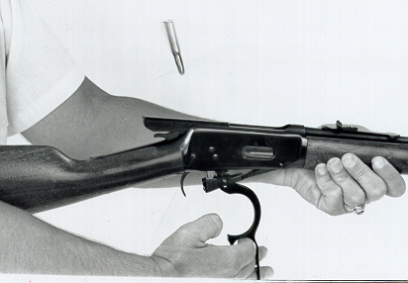
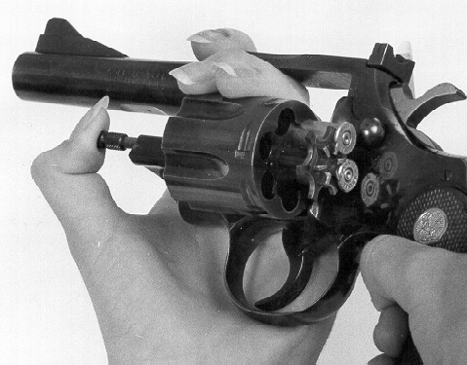
Empty Magazines, Cylinders & Guns
Slide VI-10
Built-in magazines
Box magazines
Tubular magazines
Cylinders (Revolvers)
**Count the cartridges to ensure you have the right number.**
Lesson I
Lesson II
Lesson III
Lesson IV
Lesson V
Lesson VI
Lesson VII
Notes:
Empty Magazines, Cylinders & Guns
3 Min. Cumulative Time: 34 Min.
Explain: Always count the cartridges you empty out of the magazine. Make sure the total matches the number used to fill the magazine minus those that have been fired or are still chambered.
Some guns have the magazines built right into the actions. These actions empty the magazine and unload the gun at the same time, e.g., a gun that is loaded through the side of the receiver or has a blind magazine (magazine without removable bottom).
Use only dummy cartridges or shotshells for classroom demonstrations. Remember the NRA Safe Gun Handling Rules when emptying or removing magazines. Demonstrate how to empty:
• Built-in (blind) magazines: Work the action until the magazine is empty.
• Magazines with hinged floor plates: Release floor plate to open magazine; allow cartridges to fall free of magazine.
• Removable box magazines: Press magazine release; pull magazine free of rifle; strip the cartridges out of the magazine.
• Tube magazines: Pull the inner magazine tube assembly completely out of the magazine tube (KEEP YOUR FINGERS AWAY FROM THE MUZZLE). Pour the cartridges out of the magazine.
• Cylinders:
•Single action: Half cocking the hammer maybe necessary to rotate the cylinder; open the loading gate; rotate the cylinder to align with the ejector rod and push cartridges out of the cylinder.
·Double action: Activate the cylinder release; swing the cylinder out of the frame and eject the cartridges from the chambers with the ejection rod.

Slide 75
Loading a Gun
Slide VI-11
Lesson I
Lesson II
Lesson III
Lesson IV
Lesson V
Lesson VI
Lesson VII
1.ALWAYS point the gun in a safe direction.
2.ALWAYS keep your finger off the trigger until ready to shoot.
3.Engage the mechanical safety (if possible)
4.Insert ammunition (magazine) into gun.
5.Open the action and chamber a cartridge.
6.Close the action and engage the mechanical safety.
Notes:
Loading a Gun
12 Min. Cumulative Time: 36 Min.
Explain: These six steps are the general steps used in load most guns.
Demonstrate loading the rifle. NO LIVE AMMUNITION IN THE CLASSROOM.
1. ALWAYS point the gun in a safe direction.
Ask: What is a safe direction in the classroom and why?
• Explain the NRA first rule of safe gun handling.
2. ALWAYS keep your finger off the trigger until ready to shoot. Ask: Where do you put your finger?
• The finger is straight and along the action.
• Explain the NRA second rule of safe gun handling.
3. Engage the mechanical safety (if possible).
Ask: Can the safety be engaged on all guns during the loading process?
• Explain The design of the guns will affect whether the safety can be engaged.
4. Insert the ammunition source.
• Do not put your hand in front of the muzzle.
5. Open the action and chamber a cartridge.
6. Close the action and engage the mechanical safety.

Slide 76
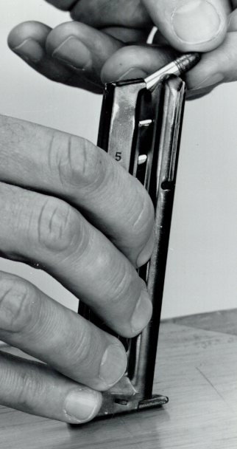
Fill Magazines and Cylinders
Slide VI-12
Built-in magazines
Box magazines
Tubular magazines
Cylinders (Revolvers)
Lesson I
Lesson II
Lesson III
Lesson IV
Lesson V
Lesson VI
Lesson VII
Notes:
Fill Magazines and Cylinders
3 Min. Cumulative Time: 39 Min.
Explain: Always count the number of cartridges you insert into the magazine and fire. When you unload and empty the magazine, all cartridges should be accounted for.
Remember the NRA Safe Gun Handling Rules when emptying or removing magazines.
Demonstrate:
Ask: How do you fill a built-in magazine?
• Bolt action with built-in magazine: Open the action; insert the cartridges into the top of the magazine; push down on the top cartridge; push the bolt forward over top of the cartridge; close the bolt on an empty chamber.
Ask: How do you fill a box magazine and insert it into the firearm?
• Removable box magazine: Insert the cartridges into the top of the magazine; insert the magazine into the magazine well; pull on the magazine to ensure it is locked in place.
Ask: How do you fill a tube magazine?
• Tube magazine: Pull the inner magazine tube assembly until its bottom is above the loading port in the tube (KEEP YOUR FINGERS AWAY FROM THE MUZZLE); insert cartridges into the tube.
Ask: How do you load a cylinder?
• Cylinders: Single action: Half cocking the hammer maybe necessary to the rotate cylinder, open the loading gate, rotate the cylinder to align an empty chamber with the loading port, insert a cartridge into a chamber, rotate the cylinder, load cartridges into remaining cylinders and close the loading gate. Double action: Activate the cylinder release, swing the cylinder out of the frame, insert cartridges into chambers, swing the cylinder back into the frame.

Slide 77
Bolt Action
Slide VI-13
Lesson I
Lesson II
Lesson III
Lesson IV
Lesson V
Lesson VI
Lesson VII
Nomenclature
Operation
Stoppages
Notes:
Bolt Action
6Min. Cumulative Time: 45 Min.
Note: Each action type has its own slide to illustrate how it functions. Students can refer to NRA Basic Handbooks for more information on specific action types.
Use slide or a firearm to identify the parts of a long gun in general, and note the purpose of each part.
Note: If you use a firearm to demonstrate, be sure to have a second person inspect it.
Use only dummy cartridges or dummy shotshells for classroom demonstrations.
Ask: How does a bolt action work?
• The bolt is lifted up and pulled completely to the rear. A round of ammunition is inserted into the receiver. When the bolt is pushed forward, the cartridge is fed into the chamber. As the bolt is lowered, the action is locked closed.
Demonstrate how to operate a bolt action by loading and unloading it.
Ask: What stoppages have you experienced with bolt-action firearms and how did you clear them?
Types of stoppages include: (If not already introduced by the class, cover the two stoppages below.)
1. Double-feed: The bolt pushes a second cartridge into the chamber, wedging two together and jamming the gun.
• Clearing stoppage: Follow NRA Safe Gun Handling Rules 1 and 2; remove the magazine and work the action several times to work the cartridge loose. If that fails, use your fingers to unwedge the cartridges.
2. Casing stuck in chamber: The fired cartridge casing will not extract from the chamber. Note: The case might not really be stuck in the chamber if the extractor is broken or not functioning properly.
• Clearing stoppage: Follow NRA Safe Gun Handling Rules 1 and 2; look at the primer to see if it has been hit by the firing pin--confirm whether you are dealing with a live or fired cartridge. Work the bolt several times easily and firmly. If that fails, fire the live cartridge downrange and use a cleaning rod from the muzzle end to push the casing out.
Explain: Whenever you handle anyone's firearm, you must be careful not to damage it or hurt yourself with any tool used to clear the firearm. If you damage a firearm you may end up paying for the repairs.

Slide 78
Lever Action
Slide VI-14
Nomenclature
Operation
Stoppages
Lesson I
Lesson II
Lesson III
Lesson IV
Lesson V
Lesson VI
Lesson VII
Notes:
Lever Action
4Min. Cumulative Time: 49 Min.
Ask: What parts are unique to a lever-action gun? How do they function?
Use slide or a firearm to identify parts of a lever action that were not covered in the overview of the long gun. Note the purpose of each part.
Ask: How does a lever action work?
• A lever-action rifle is opened by pushing the cocking lever downward and forward, away from the stock. It is closed by returning the lever back to its original position.
Demonstrate how to operate a lever action by loading and unloading it.
Types of stoppages:
• Double-feed and fired casing stuck in chamber. (If not already introduced by the class, cover these stoppages. The procedures are the same as for the bolt action.)
Demonstrate clearing the double-feed and the stuck case. Use the same procedure as in the bolt-action demonstration. You may not need to repeat this demonstration unless the class is having trouble understanding the steps

Slide 79
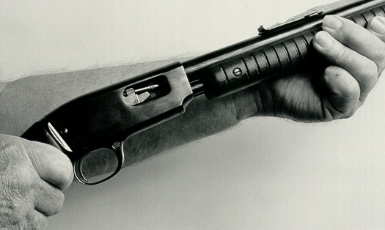
Pump Action
Slide VI-15
Nomenclature
Operation
Stoppages
Lesson I
Lesson II
Lesson III
Lesson IV
Lesson V
Lesson VI
Lesson VII
Notes:
Pump Action
4Min. Cumulative Time: 53 Min.
Ask: What parts are unique to a pump action? How do they function?
Use slide or a firearm to identify parts of a slide or pump action that were not covered in the overview of the long gun. Note the purpose of each part.
Ask: How does a pump action work?
• The forearm of the stock is pumped back and forth to open and close the action.
Demonstrate how to operate a pump action by loading and unloading it.
Ask: What stoppages have you experienced with pump-action firearms and how did you clear them?
Types of stoppages:
• Double-feed and fired casing stuck in chamber. (If not already introduced by the class, cover these two stoppages. The procedures are the same as for the bolt action.)
Demonstrate clearing the double-feed and the stuck case. Use the same procedures as in the bolt-action demonstration. You may not need to repeat this demonstration unless the class is having trouble understanding the steps

Slide 80
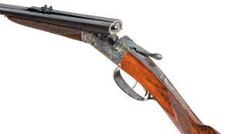
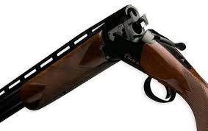
Hinged Action
Slide VI-16
Lesson I
Lesson II
Lesson III
Lesson IV
Lesson V
Lesson VI
Lesson VII
Nomenclature
Operation
Stoppages
Notes:
Hinged Action
2Min. Cumulative Time: 55 Min.
Ask: What parts are unique to a hinge action? How do they function?
Use slide or a firearm to identify parts of a hinge action that were not covered in the overview of the long gun. Note the purpose of each part.
Ask: How does a hinge action work?
• The hinge action opens like a door hinge. When the release lever is pushed to one side, the barrel swings downward and away from the breech block. A cartridge is inserted into the chamber and as the action is closed, the cartridge is locked inside the chamber.
Demonstrate how to operate a hinge action by loading and unloading it.
Ask: What stoppages have you experienced with hinge-action firearms and how did you clear them?
Type of stoppage:
• Cartridge overrides the extractor: The extractor slides past the cartridge as the action was opened.
• Fired casing stuck in chamber. (If not already introduced, do so now).
Demonstrate how to clear the stoppage.

Slide 81
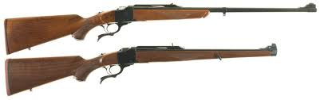
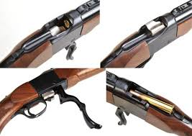
Falling Block Action
Slide VI-17
Lesson I
Lesson II
Lesson III
Lesson IV
Lesson V
Lesson VI
Lesson VII
Nomenclature
Operation
Stoppages
Notes:
Falling Block Action
2Min. Cumulative Time: 57 Min.
Ask: What parts are unique to a falling-block action? How do they function?
Use slide or a firearm to identify parts of a falling-block action that were not covered in the overview of the long gun. Note the purpose of each part.
Ask: How does a falling-block action work?
• The action is opened by lowering the trigger guard or a small lever under the action, causing the breech block to "fall" down and away from the chamber. A cartridge is inserted into the chamber and as the lever is raised, the breech block locks into place.
Demonstrate how to operate a falling-block action by loading and unloading it.
Ask: What stoppages have you experienced with falling-block action firearms and how did you clear them?
Type of stoppage:
• Cartridge overrides the extractor. (If not already introduced, do so now.)
Demonstrate how to clear the stoppage

Slide 82
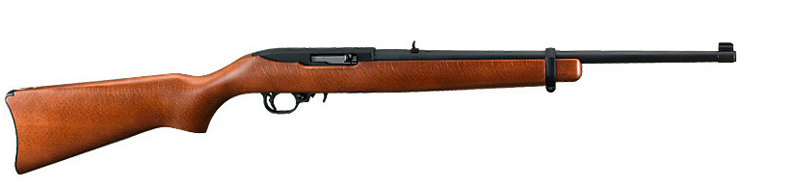
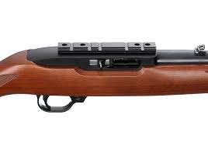
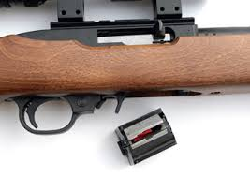
Semi-Automatic Action
Slide VI-18
Lesson I
Lesson II
Lesson III
Lesson IV
Lesson V
Lesson VI
Lesson VII
Nomenclature
Operation
Stoppages
Notes:
Semi-Automatic Action
5 Min., 10 Min. for Break Cumulative Time: 64 Min.
Ask: What parts are unique to a semi-automatic? How do they function?
Use slide or a firearm to identify parts of a semi-automatic action that were not covered in the overview of the long gun. Note the purpose of each part.
Ask: How does a semi-automatic action work?
• The semi-automatic action reloads a cartridge into the chamber each time the rifle fires. Loading is accomplished by pulling the operating handle back and releasing it, thus chambering a cartridge as the bolt returns to battery (fully locked into firing position).
Demonstrate how to operate a semi-automatic action by loading and unloading it.
Ask: What stoppages have you experienced with semi-automatic action firearms and how did you clear them?
Types of stoppages:
• Double-feed and fired casing stuck in chamber. (If not already introduced by the class, cover the two stoppages. The procedures are the same as for the bolt action.)
Demonstrate clearing the double-feed and the stuck case. Use the same procedures as in the bolt-action demonstration. You may not need to repeat this demonstration unless the class is having trouble understanding the steps

Slide 83
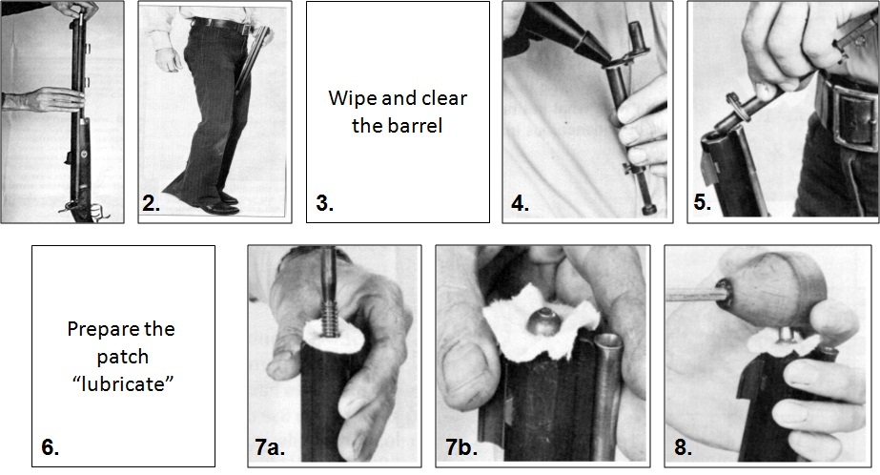
Muzzle Loading Guns
Slide VI-19
Lesson I
Lesson II
Lesson III
Lesson IV
Lesson V
Lesson VI
Lesson VII
Notes:
Muzzle Loading Guns
3 Min. Cumulative Time: 67 Min.
Use the slide or a gun to identify parts of a muzzleloading gun that were not covered in the general overview. Note the purpose of each part.
The flintlock uses a flint and frizzen to start a chain reaction to fire the gun. On a percussion muzzleloader with a hammer, the hammer strikes a percussion cap. With an in-line muzzleloading gun, a firing pin strikes a percussion cap to ignite a powder charge.
Loading: (Point the gun up and away from your body. Never work directly over the muzzle.)
1. Check the bore for a load. (Insert ramrod into barrel, mark the rod, and place it against the outside of the barrel to measure the length from muzzle to flash hole.) Use the ramrod to check if there is already a load in the barrel.
2. Half-cock and position the gun for loading. (Pull the hammer to half-cock and position the gun. Stand the gun on the ground between your legs so that the muzzle is pointed up and away from your body. Never work directly over the muzzle.)
3. Wipe and clear the barrel. (Use a clean patch with the ramrod to wipe excess oil from the bore that
might interfere with ignition or to ensure there are no sparks in the bore from the previously fired load that could set off the powder charge.)
4. Measure the powder charge. (Never pour powder directly into barrel from a powder container.)
5. Charge the barrel with powder. USE ONLY BLACK POWER ORAN APPROVED SUBSTITUTE IN MUZZLELOADING FIREARMS.
6. Prepare the patch (lubricate).
7. Patch the ball. 7a) Place the lubricated patch squarely over the muzzle of your gun. 7b) Take a single ball and center it directly over the patch.
8. "Start” the ball and patch. (Use a starter tool to insert the patch and ball into the muzzle. Place the starter tool over the ball and strike it with the heel of your hand to drive the ball flush with the muzzle.)
(continued next slide)
.

Slide 84
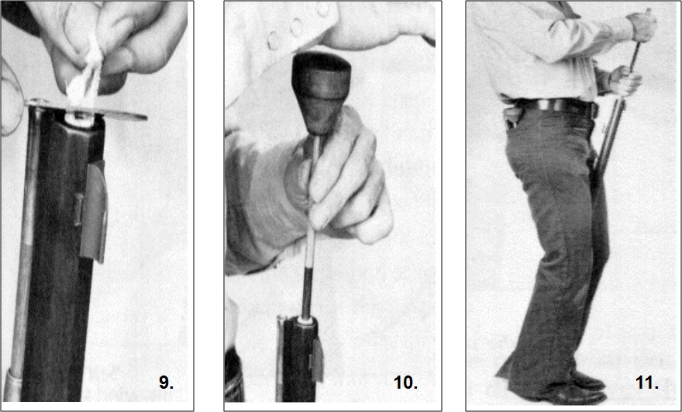
Muzzle Loading Guns
Slide VI-20
Lesson I
Lesson II
Lesson III
Lesson IV
Lesson V
Lesson VI
Lesson VII
Notes:
Muzzle Loading Guns
2Min. Cumulative Time: 69 Min.
9. Trim the patch. (Use patch knife to remove excess material not wrapped securely around the ball.)
10. "Short start" the ball. (Use the shaft on the starter tool to drive the ball down the bore).
11. "Seat" the ball. (Use the ramrod to seat the ball to the bottom of the bore.)
Demonstrate how to operate a muzzleloader by loading and unloading it.
Firing: The hammer must be cocked with the thumb. Place a cap on the nipple for a percussion gun, or prime the flash pan with powder on a flintlock. The gun is now ready to shoot.
Unloading: In the old days, you fired the gun to unload it or pulled out the ball with a special screw. Today, you can use a hand-held CO, discharger device to blow everything out of the barrel.
Ask: What stoppages have you experienced with muzzleloading guns? How did you clear them?
Types of stoppages include:
Failure to fire: There are several possibilities with muzzleloading guns--the flintlock is not properly adjusted; there is wet powder in the flash pan; there is no powder behind the ball.
• Clearing stoppage: Follow NRA Safe Gun Handling Rules 1 and 2. Wait a minimum of two minutes to ensure that the gun will not go off due to hangfire. Remove the cap or check the flint. Clear the flash channel to ensure the flash will reach the powder, then recap or re-prime. Attempt to fire. If it still fails to fire, use a hand-held CO, discharger to blow the load downrange. There are adapters designed to fit every type of muzzleloader.
Demonstrate how to clear the gun with a CO, device. (Using a ball puller on a work rod is the last resort.)

Slide 85
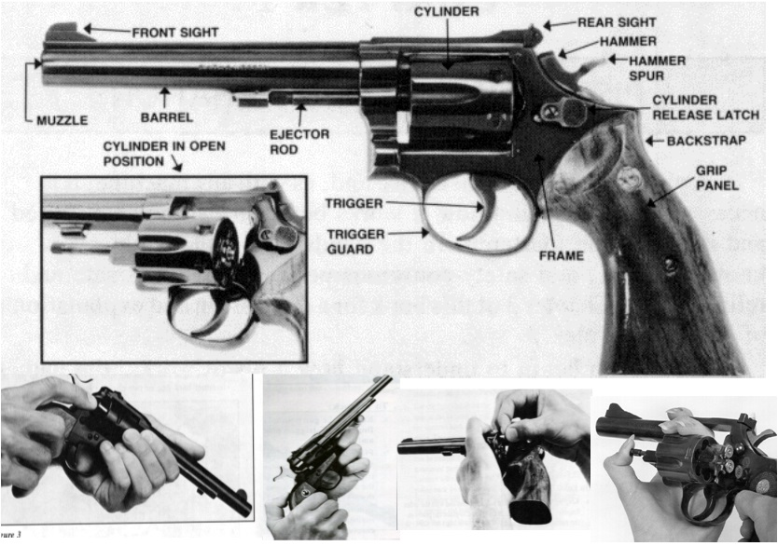
Revolvers
Slide VI-21
Nomenclature
Operation
Stoppages
Lesson I
Lesson II
Lesson III
Lesson IV
Lesson V
Lesson VI
Lesson VII
Notes:
Revolvers
5 Min. Cumulative Time: 74 Min.
Nomenclature of single- and double-action revolvers: Use the above slide of a double-action revolver to point out the general parts of revolvers. Note: Always maintain a controlling grip on the gun any time the action is worked, e.g., hammer is cocked or uncocked.
Ask: How does a revolver work?
Single-action revolvers:
• (Old Model) --With the hammer in a half-cocked position, open the loading gate. An old model should be loaded with five cartridges only and the hammer down on the empty cylinder to prevent the gun from firing if dropped on its hammer. (New Model) --Open the loading gate. The new model may be loaded with six cartridges due to a transfer bar that prevents the gun from firing if dropped on its hammer.
• Rotate the cylinder to align with the ejector rod and push cartridges out of the chambers.
• The hammer must be cocked with the thumb. As the hammer is pulled to the rear, the cylinder rotates and the cartridge aligns with the barrel. The hammer remains cocked in position until the trigger is pulled.
Double-action revolver:
• Open the cylinder and push the ejector rod to remove cartridges.
• When the trigger is pulled, the hammer both cocks and releases, and the gun fires. As the hammer moves to the rear, the cylinder rotates and a cartridge aligns with the barrel.
Ask: What parts are unique to a revolver? How do they function?
Use slide or a firearm to identify parts of revolvers that were not covered in the overview. Note the purpose of each part.
Demonstrate how to load and unload both the single- and double-action revolvers.
Ask: What stoppages have you experienced with a revolver and how did you clear them? Types of stoppages include:
1. Cylinder stuck: The cylinder will not move and the gun jams.
• Clearing stoppage: Follow NRA Safe Gun Handling Rules 1 and 2; rotate the cylinder with non-shooting hand.
2. Cylinder will not swing out: The cylinder will not swing out of the frame when the release latch is activated.
• Clearing stoppage: Follow NRA Safe Gun Handling Rules 1 and 2; check the ejector rod--it may have come loose, binding the rod to the frame. ·
3. Cartridge overrides the extractor: The extractor slides past the cartridge as the action is opened.
• Clearing stoppage: Follow NRA Safe Gun Handling Rules 1 and 2; pull the cartridge cases out of the cylinder and lift or pry them over the extractor by hand.
Demonstrate how to clear common stoppages that occur with revolvers.

Slide 86
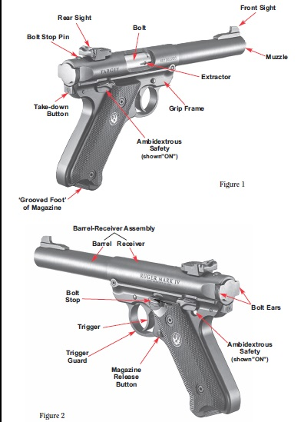
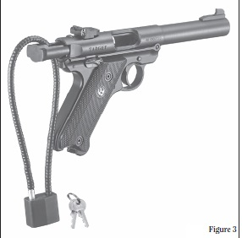
Semi-Automatic Pistols
Slide VI-22
Nomenclature
Operation
Stoppages
Lesson I
Lesson II
Lesson III
Lesson IV
Lesson V
Lesson VI
Lesson VII
Notes:
Semi-Automatic Pistols
3 Min. Cumulative Time: 77 Min.
Note: Always maintain a controlling grip on the gun any time the action is worked, e.g., hammer is cocked or uncocked; slide is operated. Use only dummy ammunition for demonstrations.
Ask: What parts are unique to a semi-automatic handgun? How do they function?
Use slide or a firearm to identify parts of a semi-automatic that were not covered in the overview.
Ask: How does a semi-automatic action work?
• The semi-automatic action reloads a cartridge into the chamber each time the pistol fires. Initial loading is accomplished by pulling the slide back and releasing it. A cartridge is chambered as the slide rebounds into position.
Explain that engaging the safety is a good habit. A mechanical safety can fail. Some safeties may have to be disengaged before the gun can be loaded or unloaded.
Demonstrate how to operate a semi-automatic by loading and unloading it

Slide 87
Semi-Automatic Pistols (cont.)
Slide VI-23
Lesson I
Lesson II
Lesson III
Lesson IV
Lesson V
Lesson VI
Lesson VII
Nomenclature
Operation
Stoppages
Notes:
Semi-Automatic Pistols
2 Min. Cumulative Time: 79 Min.
Note: Always maintain a controlling grip on the gun any time the action is worked, e.g., hammer is cocked or uncocked; slide is operated. Use only dummy ammunition for demonstrations.
Ask: What stoppages have you experienced with semi-automatics and how did you clear them? Types of stoppages include:
1. Double-feed: The slide pushes two cartridges into the chamber at the same time, wedging them together
and jamming the gun.
• Clearing stoppage: Follow NRA Safe Gun Handling Rules 1 and 2; remove the magazine; work the slide several times to work the cartridge loose. If that fails, use your fingers to unwedge the cartridges.
2. Casing stuck in chamber: The fired cartridge case will not extract from the chamber. Note: The case might not really be stuck in the chamber if the extractor is broken or not functioning properly.
• Clearing stoppage: Follow NRA Safe Gun Handling Rules 1 and 2; look at the primer to see if it has been hit by the firing pin--confirm whether you are dealing with a live or fired cartridge. Work the action several times easily and firmly. If that fails, attempt to fire the live cartridge downrange and use a cleaning rod from the muzzle end to push the case out.
Demonstrate clearing the double-feed and stuck case. (Same procedure as with long guns. Demonstrate only if students are having trouble understanding the concepts.)
3. Stove-pipe: An empty case is trapped between the slide and the barrel.
• Clearing stoppage: Follow NRA Safe Gun Handling Rules 1 and 2; rake your non-shooting hand towards your body causing the spent cartridge case to break free.
Note: Do not place your hand in front of the muzzle.

Slide 88
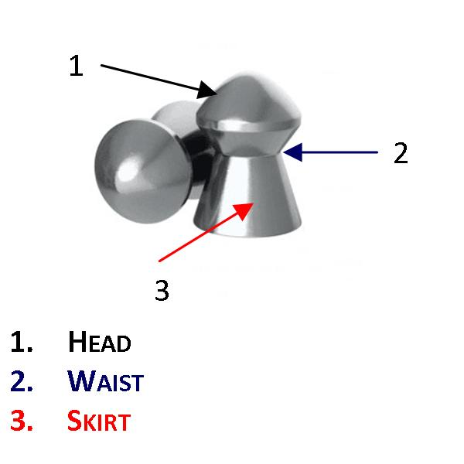
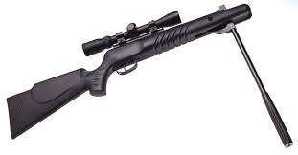
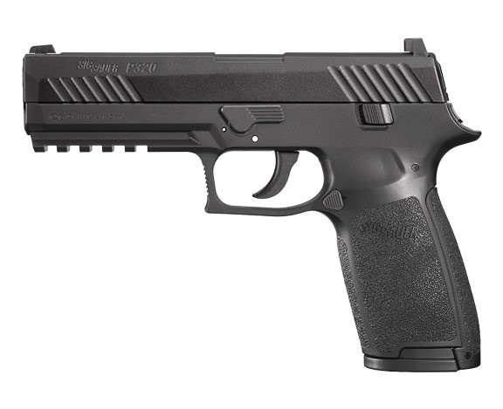
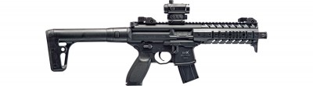
Air Guns
Slide VI-24
Nomenclature
Operation
Stoppages
Lesson I
Lesson II
Lesson III
Lesson IV
Lesson V
Lesson VI
Lesson VII
Notes:
Air Guns
5Min. Cumulative Time: 84 Min.
State that handling guns requires the same safety rules and regulations as firearms. The nomenclature of air
guns are similar to cartridge rifles and pistols. Note: If you use an air gun to demonstrate, be sure to have a second person inspect it to ensure that the air gun is unloaded.
Some air guns are single-shot guns with a simple bolt or port to insert the pellet. Other types of air guns use magazines that contain multiple projectiles. Once cocked, air guns are ready to fire.
Explain that most pellets have an hourglass shape and come in .177, .22, or .25 caliber. The nose portion of the pellet is called the head. The constricted middle portion is known as the waist, and the base portion is known as the skirt.
Ask: How does an air gun action work?
• On a bolt action, the bolt is lifted up and pulled back. A pellet is inserted into the chamber. When the bolt is pushed forward, the pellet is chambered. As the bolt is lowered, it locks the action closed.
• The hinge action opens like a door hinge. The barrel swings downward and away from the breech block. A
pellet is inserted into the chamber, and as the action is closed, the pellet is locked inside the chamber.
Demonstrate how to operate an air gun.
Simulate loading and unloading the air gun. Example of a stoppage:
Failure to fire: The gun fails to fire. The power source is defective.
• Clearing stoppage: Follow NRA Safe Gun Handling Rules 1 and 2; point gun downrange and attempt to fire. Open the action and use a cleaning rod from the breech end to push the pellet out. If that is not possible, push from the muzzle end. Always keep the muzzle pointed away from your body and in a safe direction.
Note: Always wear eye protection on the range. Pellets can ricochet back to the firing line.

Slide 89
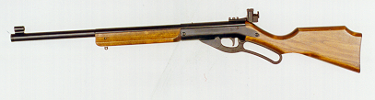
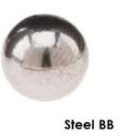
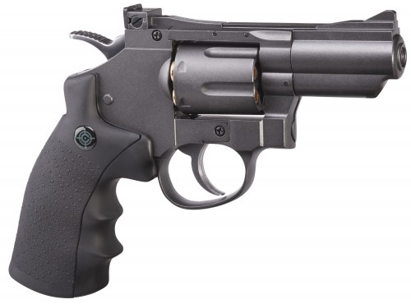
BB Guns
Slide VI-25
Lesson I
Lesson II
Lesson III
Lesson IV
Lesson V
Lesson VI
Lesson VII
Nomenclature
Operation
Stoppages
Notes:
BB Guns
5 Min. Cumulative Time: 89 Min.
BB guns are a popular type of gun. Use the slide or a BB gun to identify parts. Note: If you use a BB gun to demonstrate, be sure to have a second person inspect it to ensure the gun is unloaded. BB guns may be single shot or repeaters.
Explain that the term BB is used to describe the spherical steel or lead projectile. Steel BBs actually have a maximum diameter of .175 inch; lead BBs are .177 inch in diameter.
Ask: How does a BB gun work?
• A lever-action BB rifle is opened by pushing the cocking lever downward and away from the stock. It is closed by returning the lever to its original position.
Demonstrate how to operate an BB gun.
Simulate loading and unloading the BB gun.
Note: Always wear eye protection on an air gun range. BBs can ricochet back to the firing line

Slide 90
Stoppages on the Firing Line
Slide VI-26
Lesson I
Lesson II
Lesson III
Lesson IV
Lesson V
Lesson VI
Lesson VII
The shooter raises his hand for assistance.
RSO talks the shooter through the clearing procedure.
RSO takes the gun to clear.
**A loaded gun never leaves the firing line!**
Notes:
Stoppages on the Firing Line
3 Min. Cumulative Time: 92 Min.
Ask: When would the RSO instruct shooters on how to signal for assistance?
• During the range safety briefing.
Ask: What system does your range use to signal for assistance?
• The shooter raises the non-shooting hand for assistance. The shooter maintains control of the gun with the shooting hand.
Ask: Does your range have a policy on touching shooters while assisting them?
• If not, your club or range may want to consider it.
Explain: If you are not familiar with the gun, ask the owner if they have the owner's manual for the gun. If the owner's manual is not available, ask if anyone on the range is familiar with the gun. The final step would be to work the action and try to clear it by firing all the ammunition in the gun and then inspecting it again to ensure it is unloaded.
Ask: What is meant by "a loaded gun never leaves the firing line?"
• Do not remove guns from the firing line with a live cartridge or a projectile in the chamber or magazine. A gunsmith may have to come to the firing line to assist with the stoppage or malfunction.

Slide 91
Clearing Exercise
Slide VI-27
The Shooter will:
Set up the stoppage.
Raise hand for assistance.
Explain problem to RSO.
Follow RSO guidance then ask RSO to clear gun and observe proper procedure.
The RSO will:
Approach shooter in correct manner.
Listen to problem and ask questions as needed.
Talk shooter through clearing procedure.
Take gun out of shooters control and clear.
Return gun to the shooter
Lesson I
Lesson II
Lesson III
Lesson IV
Lesson V
Lesson VI
Lesson VII
Notes:
Clearing Exercise
5 Min., 50 Min. for Exercise. (Work in break during exercise.)
Cumulative Time: 147 Min.
Establish a range:
• Use tables for benches.
• Firing line and firing points.
• Place an unloaded gun at each firing point.
• One shooter and one RSO per firing point.
Conduct of the clearing exercise:
• The shooter and the RSO will trade roles at each firing point until all gun types are cleared.
• Make sure all RSO students complete each station.
The shooter will:
-- Set up the stoppage.
-- Raise hand for assistance.
-- Explain the problem to the RSO.
-- Follow the instructions of the RSO, then ask the RSO to clear the gun to observe the proper procedure.
The RSO will:
-- Ask how he may assist the shooter.
-- Listen to the problem and ask questions if needed.
-- Talk the shooter through the clearing procedure.
-- Take the gun out of the shooter's control and clear it.
-- Return the gun to the shooter.

Slide 92
Lesson VI: Review
Slide VI-28
Learning Objectives
Upon completing this lesson, you should be able to:
Explain the difference between a stoppage and a malfunction.
Demonstrate how to safely take a gun from a shooter.
Demonstrate how to clear common stoppages.
What are your questions?
Lesson I
Lesson II
Lesson III
Lesson IV
Lesson V
Lesson VI
Lesson VII
Notes:
Lesson VI: Conclusion
2Min. Cumulative Time: 149 Min.
Review learning objectives.
Ask: What is a stoppage?
• A stoppage is an unintentional interruption in the operational cycle of a gun that locks up the action, keeping it from functioning properly. Stoppages can be cleared from a gun quickly, returning it to an operational condition.
Ask: What is a malfunction?
• A malfunction is a failure of a gun to function as designed. Malfunctions may require the gun to be repaired to restore it to a properly functioning condition.
Ask: Is everyone confident that he or she can safely take a loaded gun from a shooter?
• If anyone is not sure, provide additional training.
Ask: Is everyone confident that he or she can clear a stoppage?
• If anyone is not sure, provide additional training

Slide 93
Lesson VII: Preview
Slide VI-29
Lesson I
Lesson II
Lesson III
Lesson IV
Lesson V
Lesson VI
Lesson VII
In Lesson VII; you will:
Take the written examination.
Grade the examination.
What are your questions?
Notes:
Lesson VII: Preview
1 Min. Cumulative Time: 150 Min.
Explain that next lesson is the written test Announce the amount of time allotted for the break and what time the test will begin. Remind students to sharpen their pencils!
Be sure each student understands the correct answers.

Slide 94
Lesson VII: Course Exam & Review
Slide VII-0
Learning Objectives
In this lesson, you will:
Pass the Range Safety Officer course’s written examination.
Understand the procedure for finalizing the credentialing process with the NRA at: www.NRAInstructors.org.
Lesson I
Lesson II
Lesson III
Lesson IV
Lesson V
Lesson VI
Lesson VII
Notes:
Lesson VII: Course Exam & Review
Learning Objectives
In this lesson, you will:
Pass the Range Safety Officer course’s written examination.
Understand the procedure for finalizing the credentialing process with the NRA at: www.NRAInstructors.org.
=============================
LEARNING OBJECTIVES: Upon completion of this lesson, students should be able to:
1. Pass the NRA's Range Safety Officer test.
2. Understand the procedure for finalizing credentialing with the NRA.
Length: 90 Minutes
Facility: Classroom
Training Materials:
• NRA Range Safety Officer Test (one per student)
• NRA Range Safety Answer Sheet (one per student)
• NRA Range Safety Officer Test Key
• Pencils (one per student)
• Viewgraphs
• Training aids as appropriate: chalk, eraser, blackboard, flipchart, easel, markers, overhead projector, bulbs, screen, etc.
Reference:
NRA Basic Range Safety Officer Course Student Study Guide

Slide 95
Course Exam
Slide VII-1
Lesson I
Lesson II
Lesson III
Lesson IV
Lesson V
Lesson VI
Lesson VII
Open book and notes.
Time: 60 minutes.
If you need assistance, let me know.
Notes:
Course Exam
1 Min., 59 Min. for Test. Cumulative Time: 60 Min.
Explain:
• The time limit is 60 minutes for the test.
• This examination is an open book test.
• If you need help, raise your hand for assistance.
Remain available during the test to explain questions to students

Slide 96
Course Exam Review
Slide VII-2
Lesson I
Lesson II
Lesson III
Lesson IV
Lesson V
Lesson VI
Lesson VII
The Examination Requirements.
90% or higher score required to pass.
Review questions missed.
Chief Range Safety Officer signs off on passing test.
Notes:
Course Exam Review
2 Min., 23 Min. for Review. Cumulative Time: 85 Min. Explain:
• Passing score is 90 percent or higher.
• Students are to exchange answer sheets.
• Students take turns reading the test questions and giving the answers.
Ensure correct answer is given and explain correct answer if necessary.
Once the review is complete, have the students total the test scores and return answer sheets to the owners. Each question is worth two points.
Sign off on passing scores. Inform students that additional training is available to those who score below 90 percent on the test.
Report training at www.nrainstructors.org. Generally, 24-48 hours after the report is submitted by the trainer, Range Safety Officer candidates will have 30 days to register and log in at NRAinstructors.org using their NRA member identification number to complete their credentials processing. Those that are not currently NRA members will need to wait until a non-member identification number is assigned, and they are notified by email. Part of this process will be a requirement for candidates' to acknowledge and agree to a disclaimer and pay the appropriate credentialing fee, which varies depending on NRA membership status. Once this is accomplished, candidates will be able to print and/or download their certificate and ID card. In order to be an NRA certified Range Safety Officer, individuals will need access to an electronic device that can be used to log in to NRAInstructors.org, a valid email address, and may find it useful to have some method to print or download items from NRAinstructors.org.

Slide 97
CRSO Submits Course Report
Slide VII-3
Lesson I
Lesson II
Lesson III
Lesson IV
Lesson V
Lesson VI
Lesson VII
In 24-48 hours after the report is submitted:
Range Safety Officer candidates will have 30 days to register and log in at NRAInstructors.org using their NRA member identification number to complete their credentials processing.
Those that are not currently NRA members will need to wait until a non-member identification number is assigned, and they are notified by email. Please review these procedures on the following slides.
Notes:
CRSO Submits Course Report
In 24-48 hours after the report is submitted:
Range Safety Officer candidates will have 30 days to register and log in at NRAInstructors.org using their NRA member identification number to complete their credentials processing.
Those that are not currently NRA members will need to wait until a non-member identification number is assigned, and they are notified by email. Please review these procedures on the following slides.

Slide 98
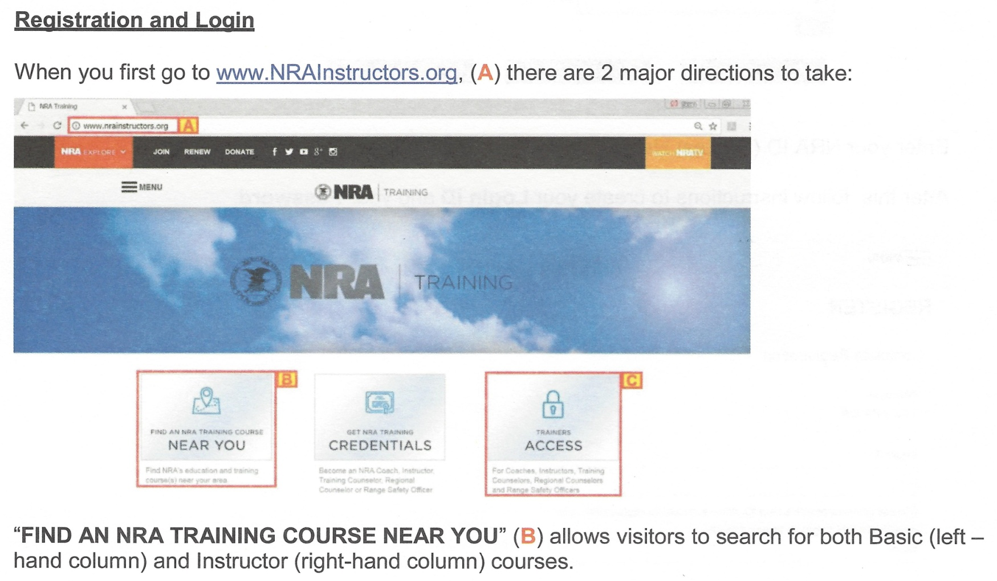
NRAINSTRUCTORS.ORG
Candidate Registration
Slide VII-4
Lesson I
Lesson II
Lesson III
Lesson IV
Lesson V
Lesson VI
Lesson VII
Notes:
NRA Trainers, Coaches and RSO Registration on NRAInstructors.org
Navigate your browser to nrainstructors.org.
Click on the right tile labelled “Trainer’s Access.”

Slide 99
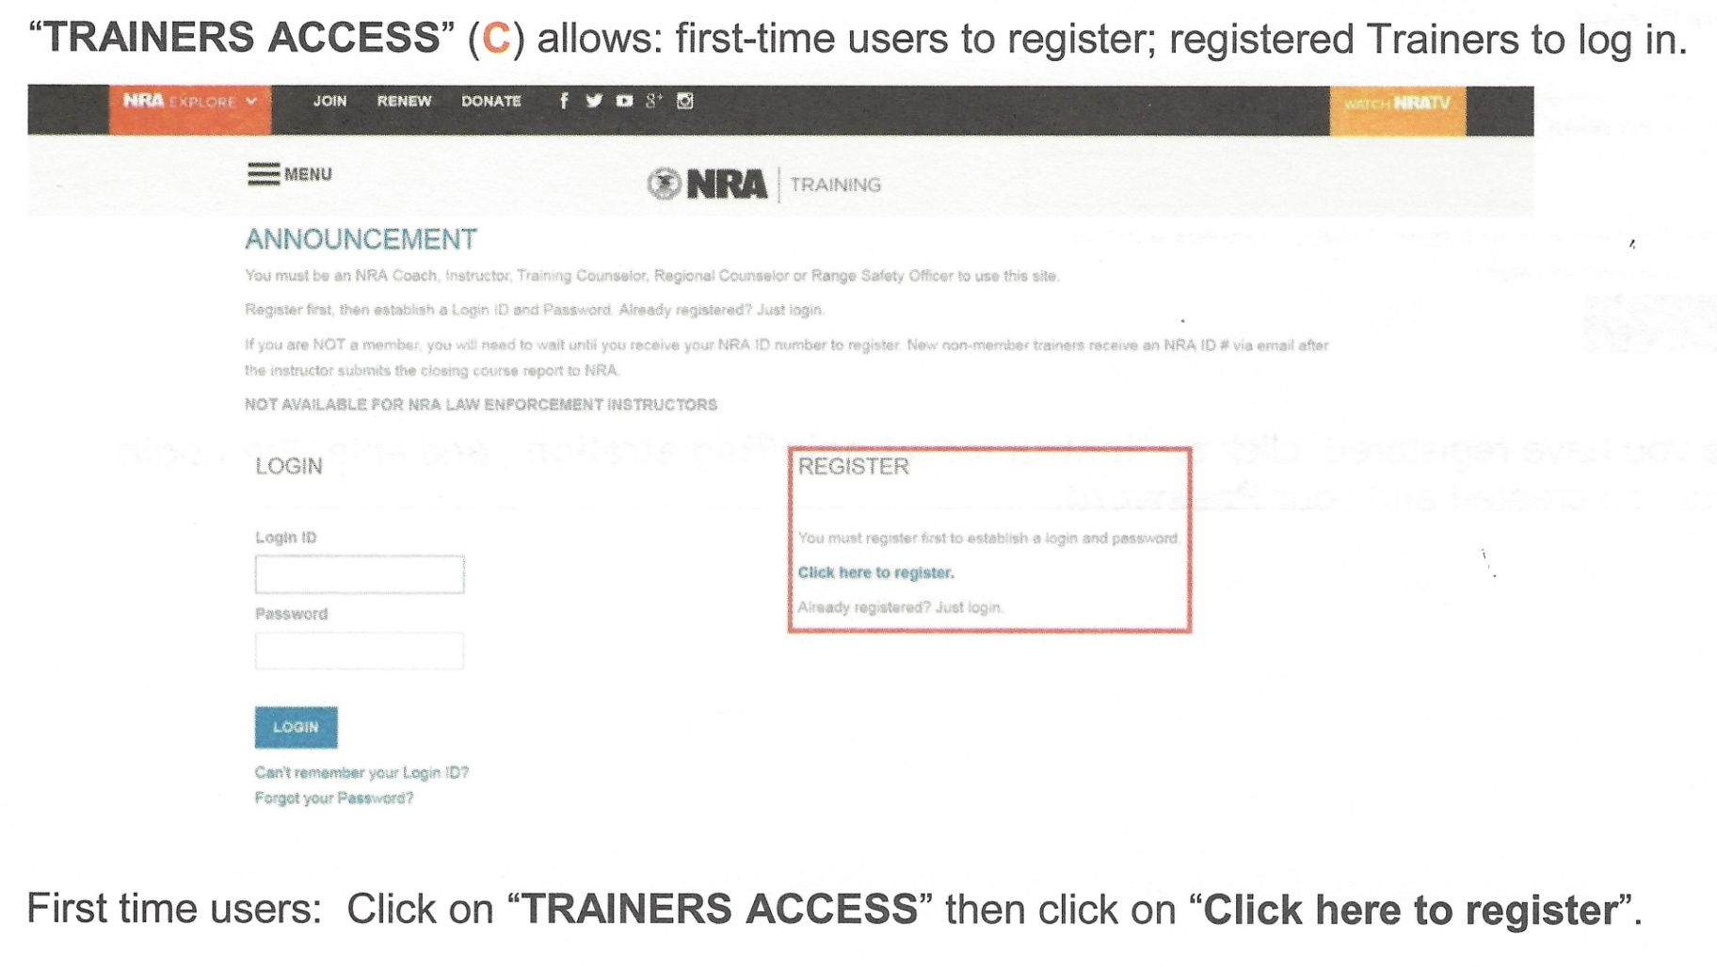
NRAINSTRUCTORS.ORG
Candidate Registration
Slide VII-4A
Lesson I
Lesson II
Lesson III
Lesson IV
Lesson V
Lesson VI
Lesson VII
Notes:
NRA Trainers, Coaches and RSO Registration on NRAInstructors.org (continued)
First time users: Click on the hyperlink “Click Here to Register.”

Slide 100
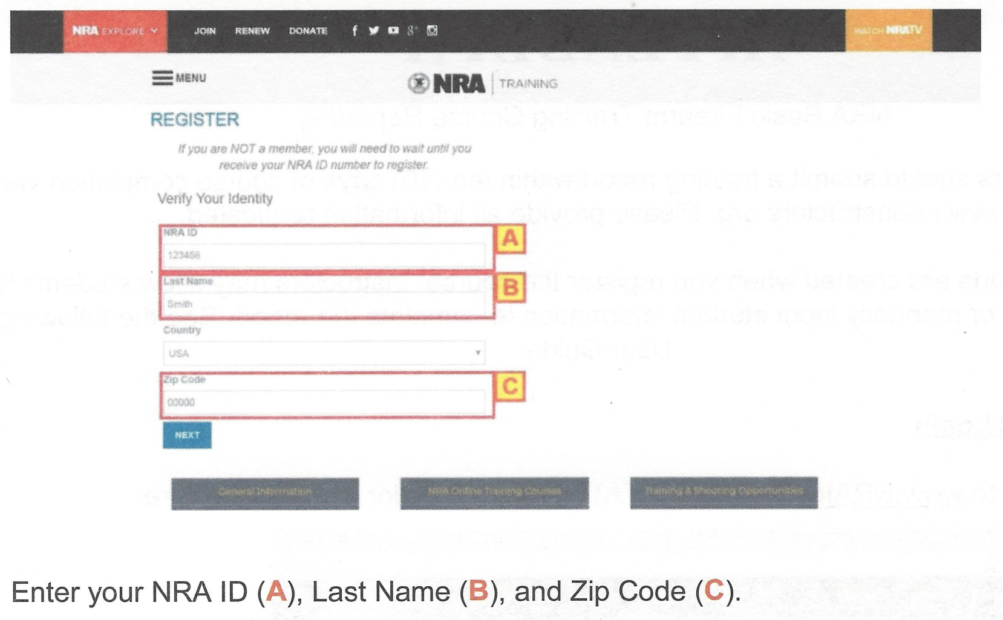
NRAINSTRUCTORS.ORG
Candidate Registration
Slide VII-5
Lesson I
Lesson II
Lesson III
Lesson IV
Lesson V
Lesson VI
Lesson VII
Notes:
NRA Trainers, Coaches and RSO Registration on NRAInstructors.org (continued)
Enter your NRA ID (Text field A).
Enter your Last Name (Text Field B).
Enter your Zip Code (Text Field C).

Slide 101
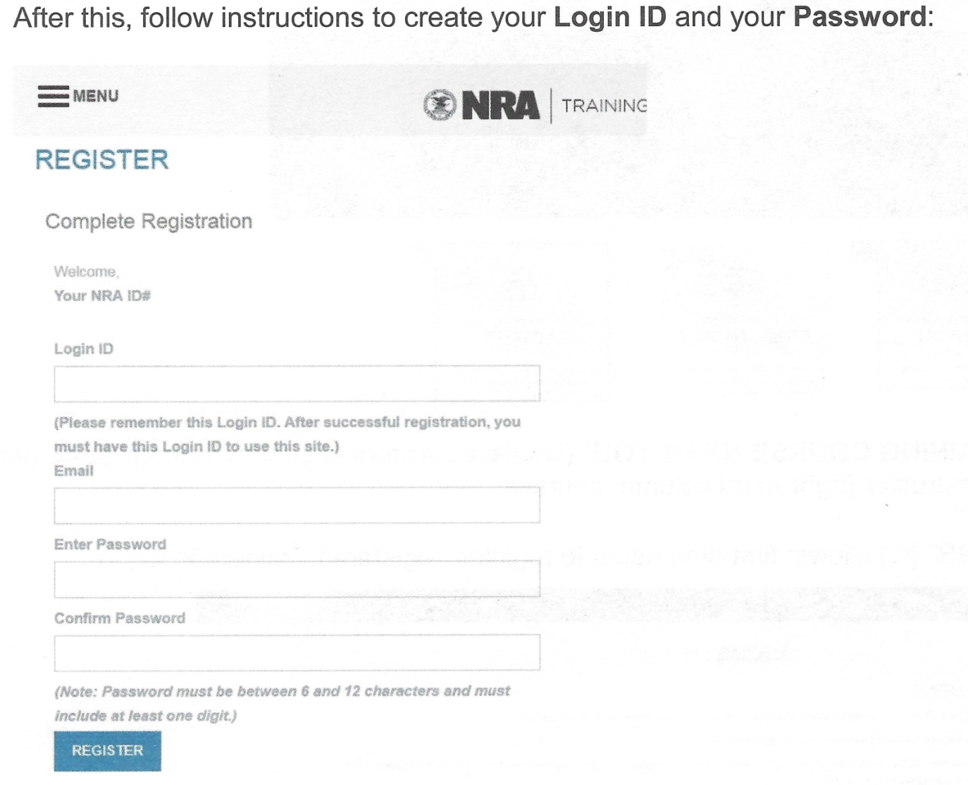
NRAINSTRUCTORS.ORG
Candidate Registration
Slide VII-5A
Lesson I
Lesson II
Lesson III
Lesson IV
Lesson V
Lesson VI
Lesson VII
Notes:
NRA Trainers, Coaches and RSO Registration on NRAInstructors.org (continued)
Create your login ID.
Enter your contact Email Address.
Enter the password your wish to use for this account.
Click “Register.”
It is important to remember your login ID.

Slide 102
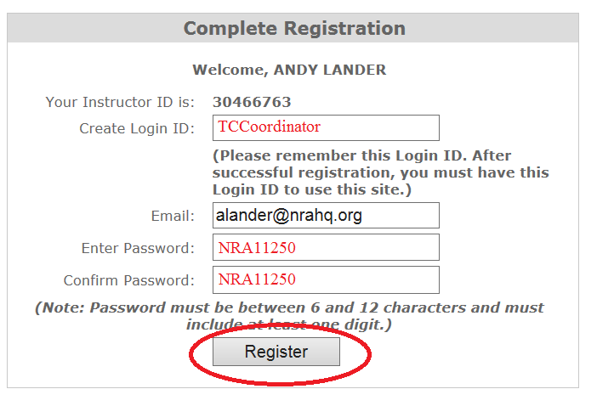
NRAINSTRUCTORS.ORG
Candidate Registration
Slide VII-6
Lesson I
Lesson II
Lesson III
Lesson IV
Lesson V
Lesson VI
Lesson VII
Notes:
NRA Trainers, Coaches and RSO Registration on NRAInstructors.org (continued)
Review and confirm your information entered.
If correct, click “Register.”

Slide 103
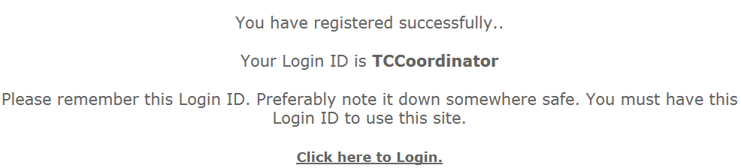
NRAINSTRUCTORS.ORG
Candidate Registration
Slide VII-7
Lesson I
Lesson II
Lesson III
Lesson IV
Lesson V
Lesson VI
Lesson VII
Notes:
NRA Trainers, Coaches and RSO Registration on NRAInstructors.org (continued)
This window will display, letting you know that your registration is successfully completed.
Click on the link: “Click here to Login.”

Slide 104
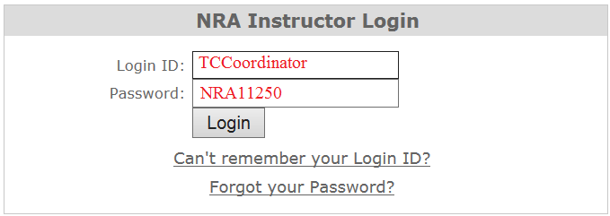
NRAINSTRUCTORS.ORG
Candidate Registration
Slide VII-8
Lesson I
Lesson II
Lesson III
Lesson IV
Lesson V
Lesson VI
Lesson VII
Notes:
NRA Trainers, Coaches and RSO Registration on NRAInstructors.org (continued)
Enter your Login ID.
Enter your account password.
Click “Login” button to access your home page.

Slide 105
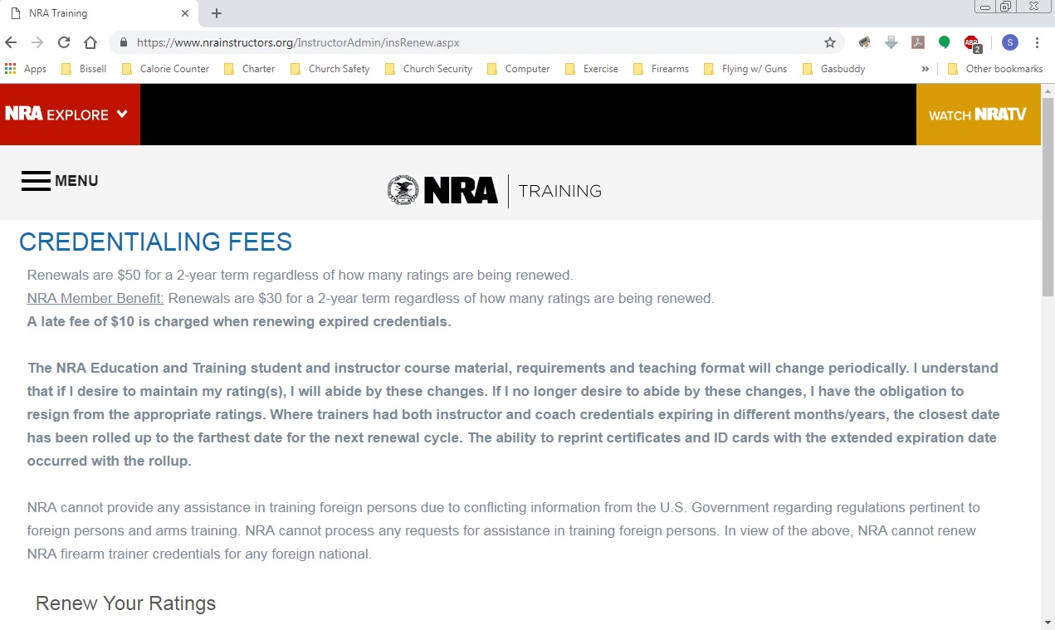
NRAINSTRUCTORS.ORG
Candidate Registration
Slide VII-9
Lesson I
Lesson II
Lesson III
Lesson IV
Lesson V
Lesson VI
Lesson VII
Notes:
NRA Trainers, Coaches, and Ransge Safety Officer Credentialing Fees:
You will need to finalize your credentialing process by paying for the ratings to become active.
Non Member Fees
First time Non NRA Member instructors, Coaches, and Range Safety Officers pay a flat credentialing fee of $60 for a 2 year term.
Additional ratings can be added at a rate of $30 per rating.
Renewals are $60 for a 2 year term regardless of how many ratings are being renewed.
NRA Member Fees
NRA Members credentialing fees are $35 for a 2 year term.
Additional ratings can be added at $15 per rating.
Trainers who have both instructor and Coach credentials expiring in different months/years will have the closest date rolled up to the farthest date for your renewal cycle.

Slide 106
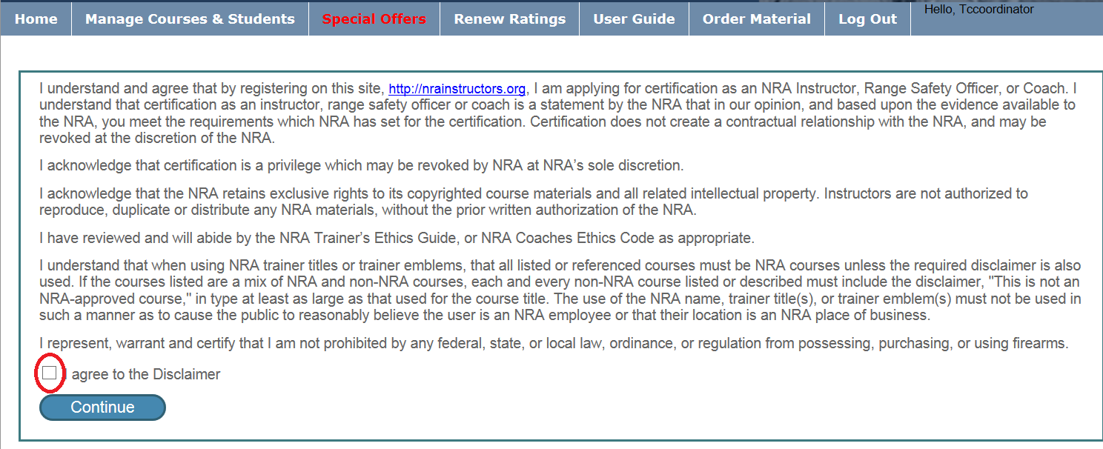
NRAINSTRUCTORS.ORG
Candidate Registration
Slide VII-10
Lesson I
Lesson II
Lesson III
Lesson IV
Lesson V
Lesson VI
Lesson VII
Notes:
NRA Trainers, Coaches and RSO Disclaimer
Read and review the disclaimer.
Check the box that “you agree to the terms of the disclaimer.”

Slide 107
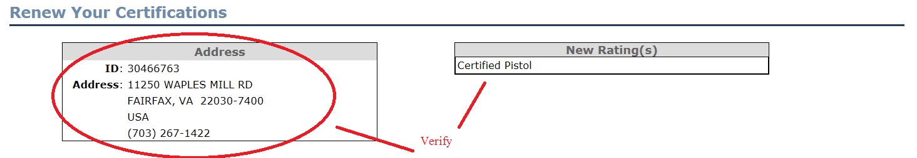
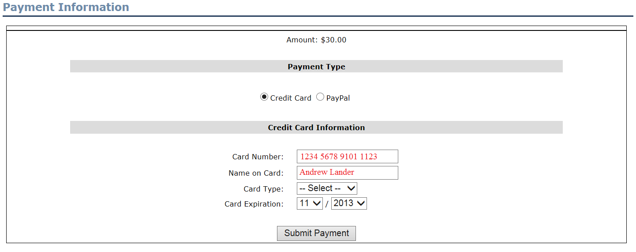
NRAINSTRUCTORS.ORG Credentialing Payment
Slide VII-11
Lesson I
Lesson II
Lesson III
Lesson IV
Lesson V
Lesson VI
Lesson VII
Notes:
NRA Trainers, Coaches and RSO Registration on NRAInstructors.org (continued)
Complete your payment fields to pay for the ratings listed to be finalized.

Slide 108
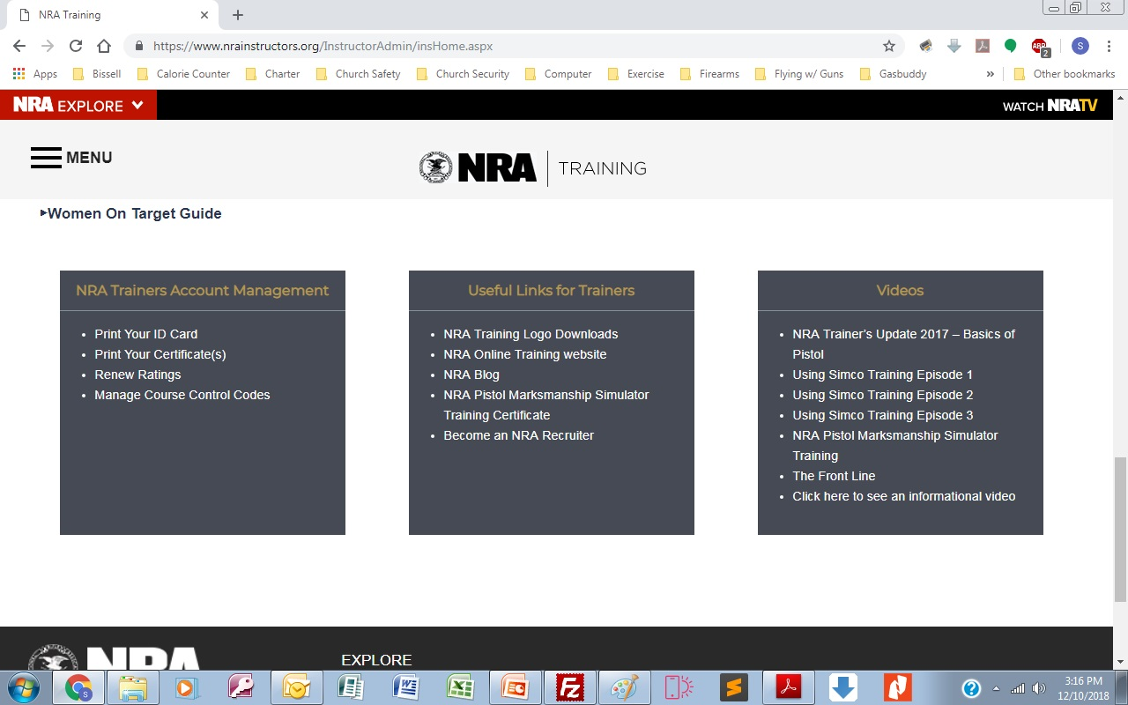
NRAINSTRUCTORS.ORG
ID Card / Certificate
Slide VII-12
Lesson I
Lesson II
Lesson III
Lesson IV
Lesson V
Lesson VI
Lesson VII
Notes:
NRA Trainers, Coaches and RSO Registration on NRAInstructors.org (continued)
Upon successful payment, you will be redirected to your home page.
Scroll down the page to the three grey tiles.
The left tile will give you the option to print your ID card and certificate.

Slide 109
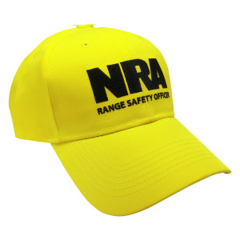
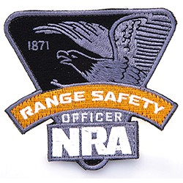

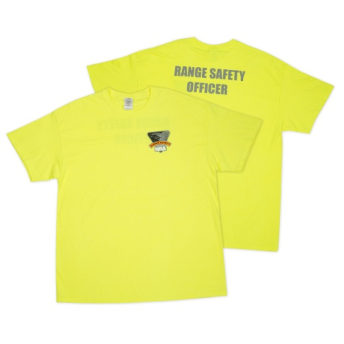
NRAINSTRUCTORS.ORG
Candidate Registration
Slide VII-13
Lesson I
Lesson II
Lesson III
Lesson IV
Lesson V
Lesson VI
Lesson VII
Some of the RSO items available at :
https://www.nrastore.com/gear/instructor-gear/
Notes:
Some of the RSO items available at : https://www.nrastore.com/gear/instructor-gear/

Slide 110
Lesson VII: Conclusion
Slide VII-14
Lesson I
Lesson II
Lesson III
Lesson IV
Lesson V
Lesson VI
Lesson VII
Learning Objectives
As a result of this lesson, you:
Passed the NRA Range Safety Officer course’s written examination.
Understand the procedure for finalizing the credentialing process with the NRA at: www.NRAInstructors.org.
Course Evaluations
Presentation of Course Completion Cards
What are your questions?
Notes:
Lesson VII: Conclusion
Learning Objectives
As a result of this lesson, you:
Passed the NRA Range Safety Officer course’s written examination.
Understand the procedure for finalizing the credentialing process with the NRA at: www.NRAInstructors.org.
Presentation of Course Completion Cards
What are your questions?

